Slide 1
20 litre container garden

Slide 2
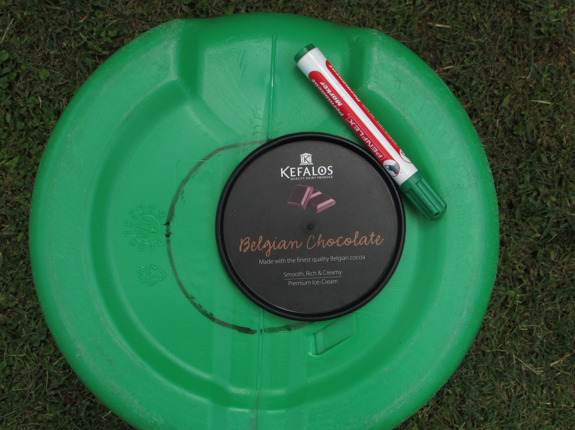
Mark a circle
of 120 mm D

Slide 3
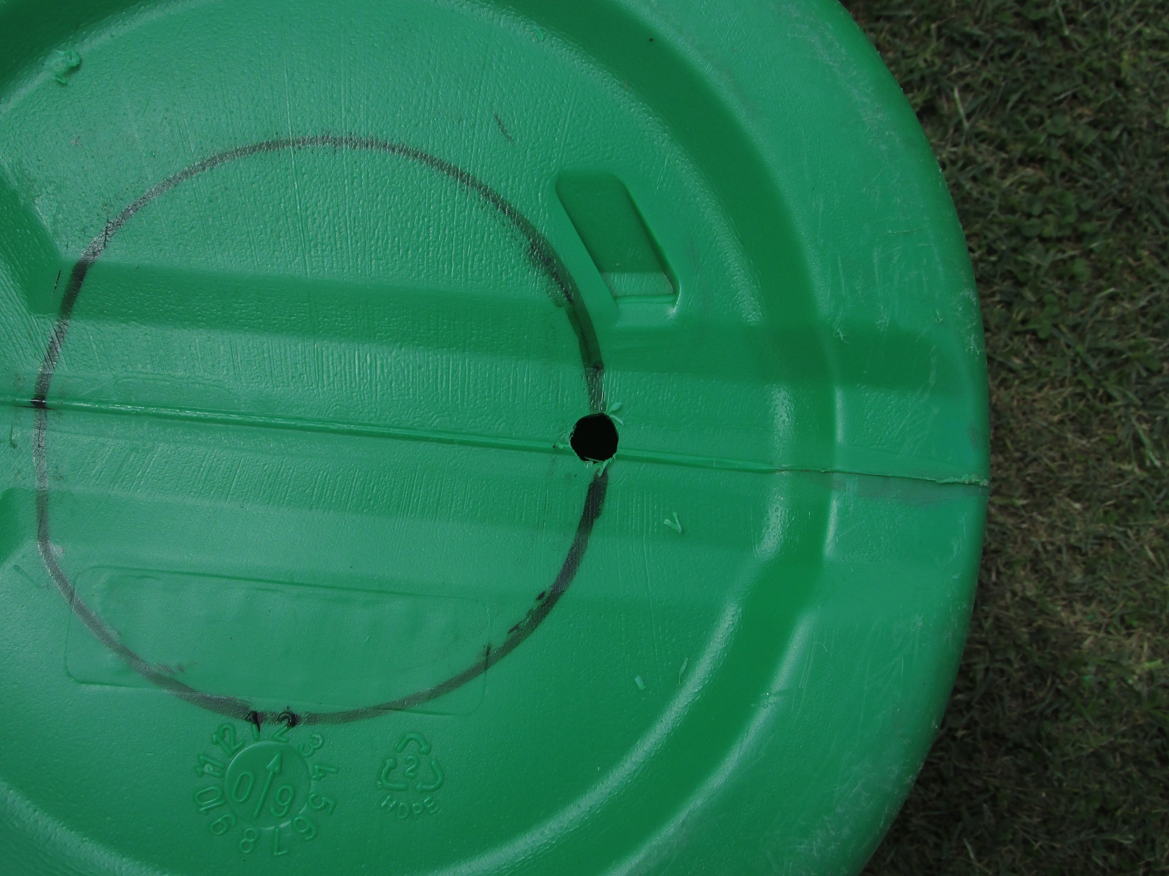
Drill a 10mm starter hole

Slide 4
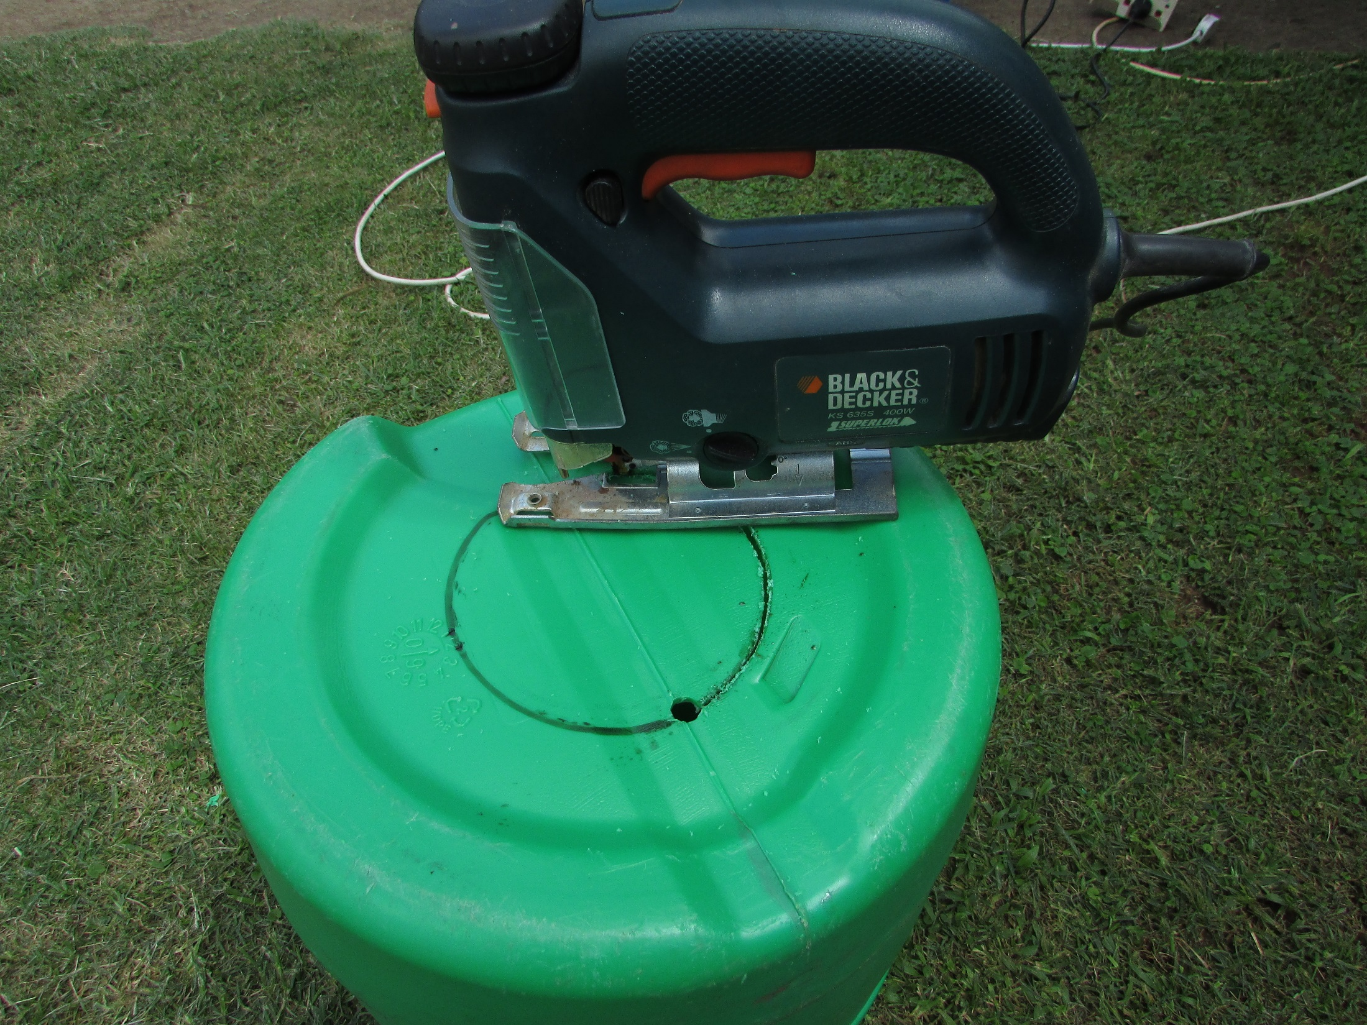
Cut out the circle

Slide 5
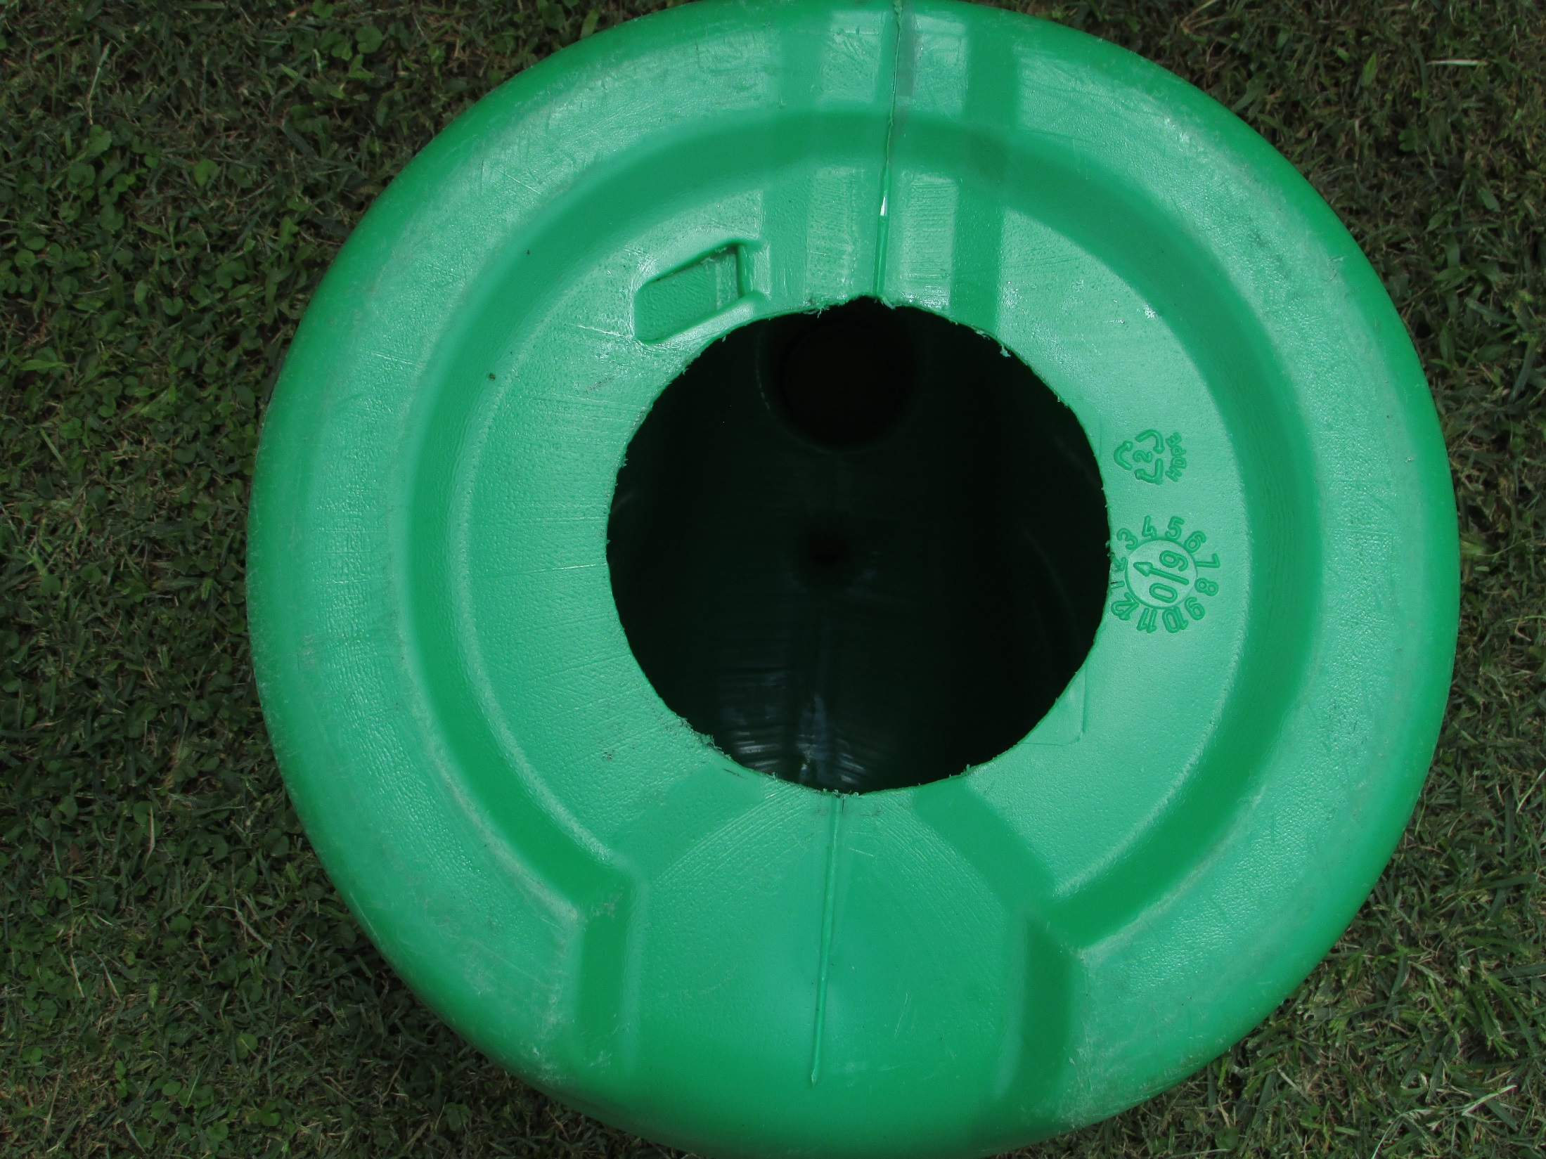

Slide 6
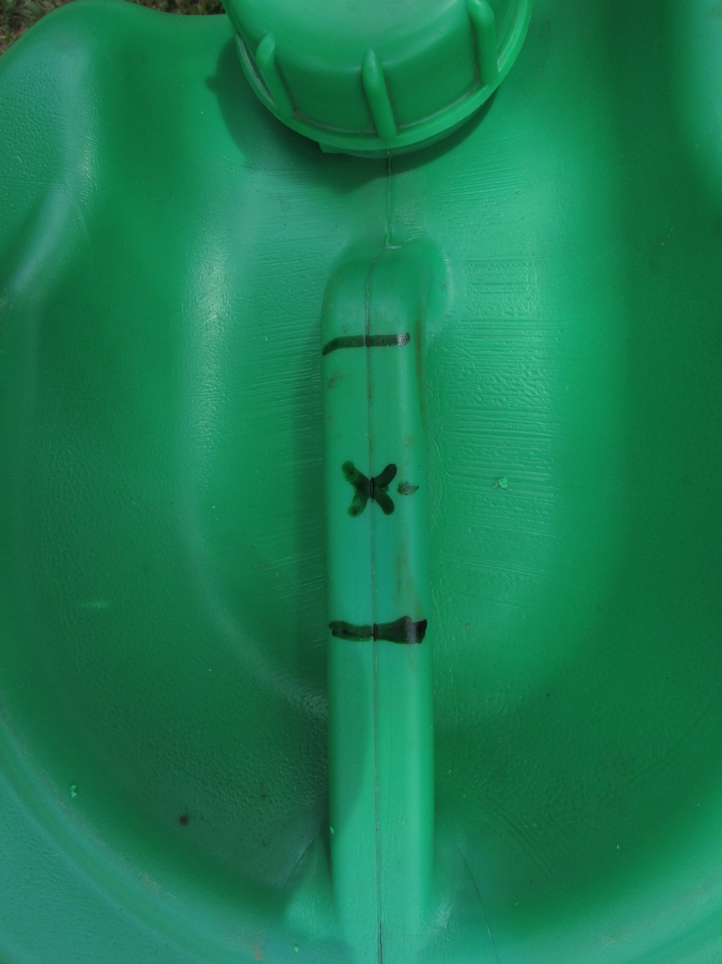

Slide 7
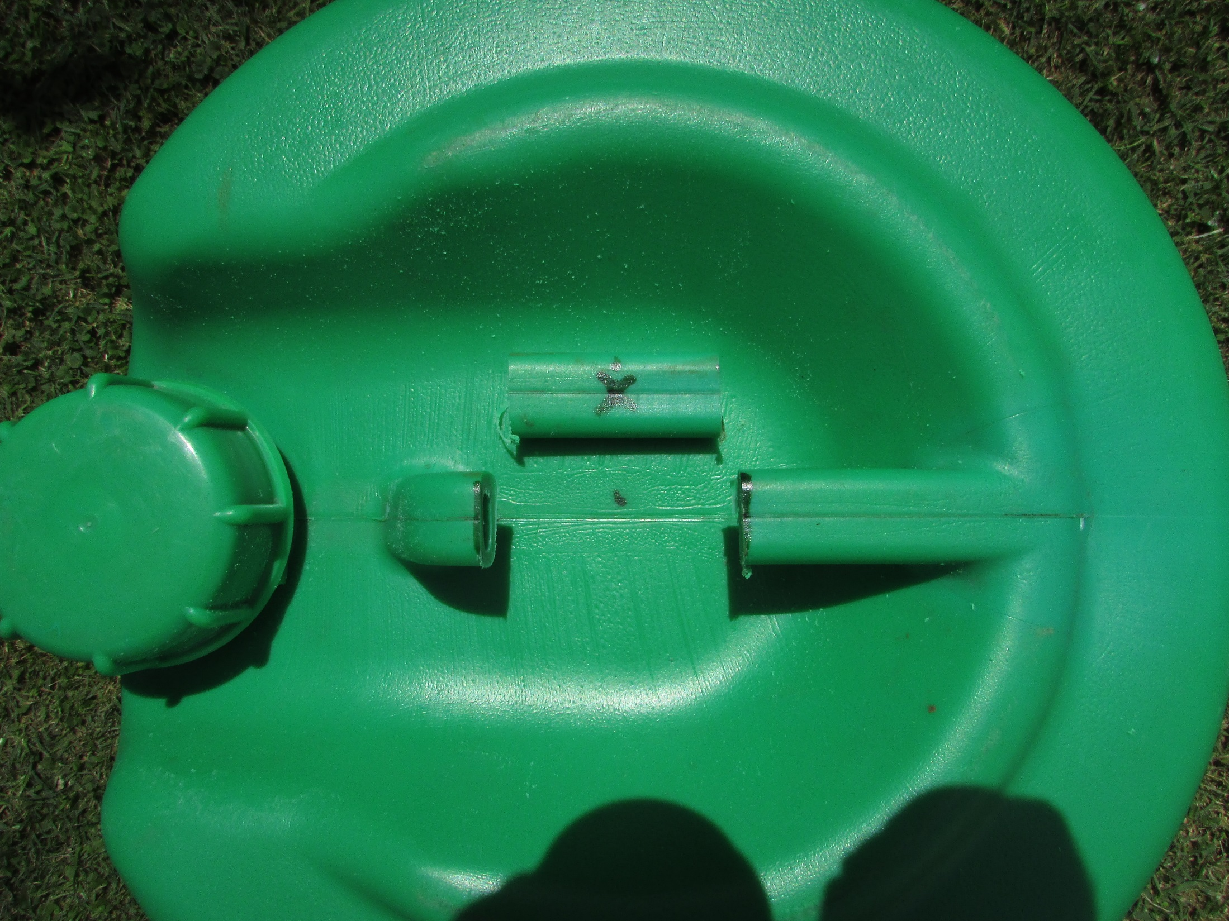
Cut the handle above
the centre point.

Slide 8
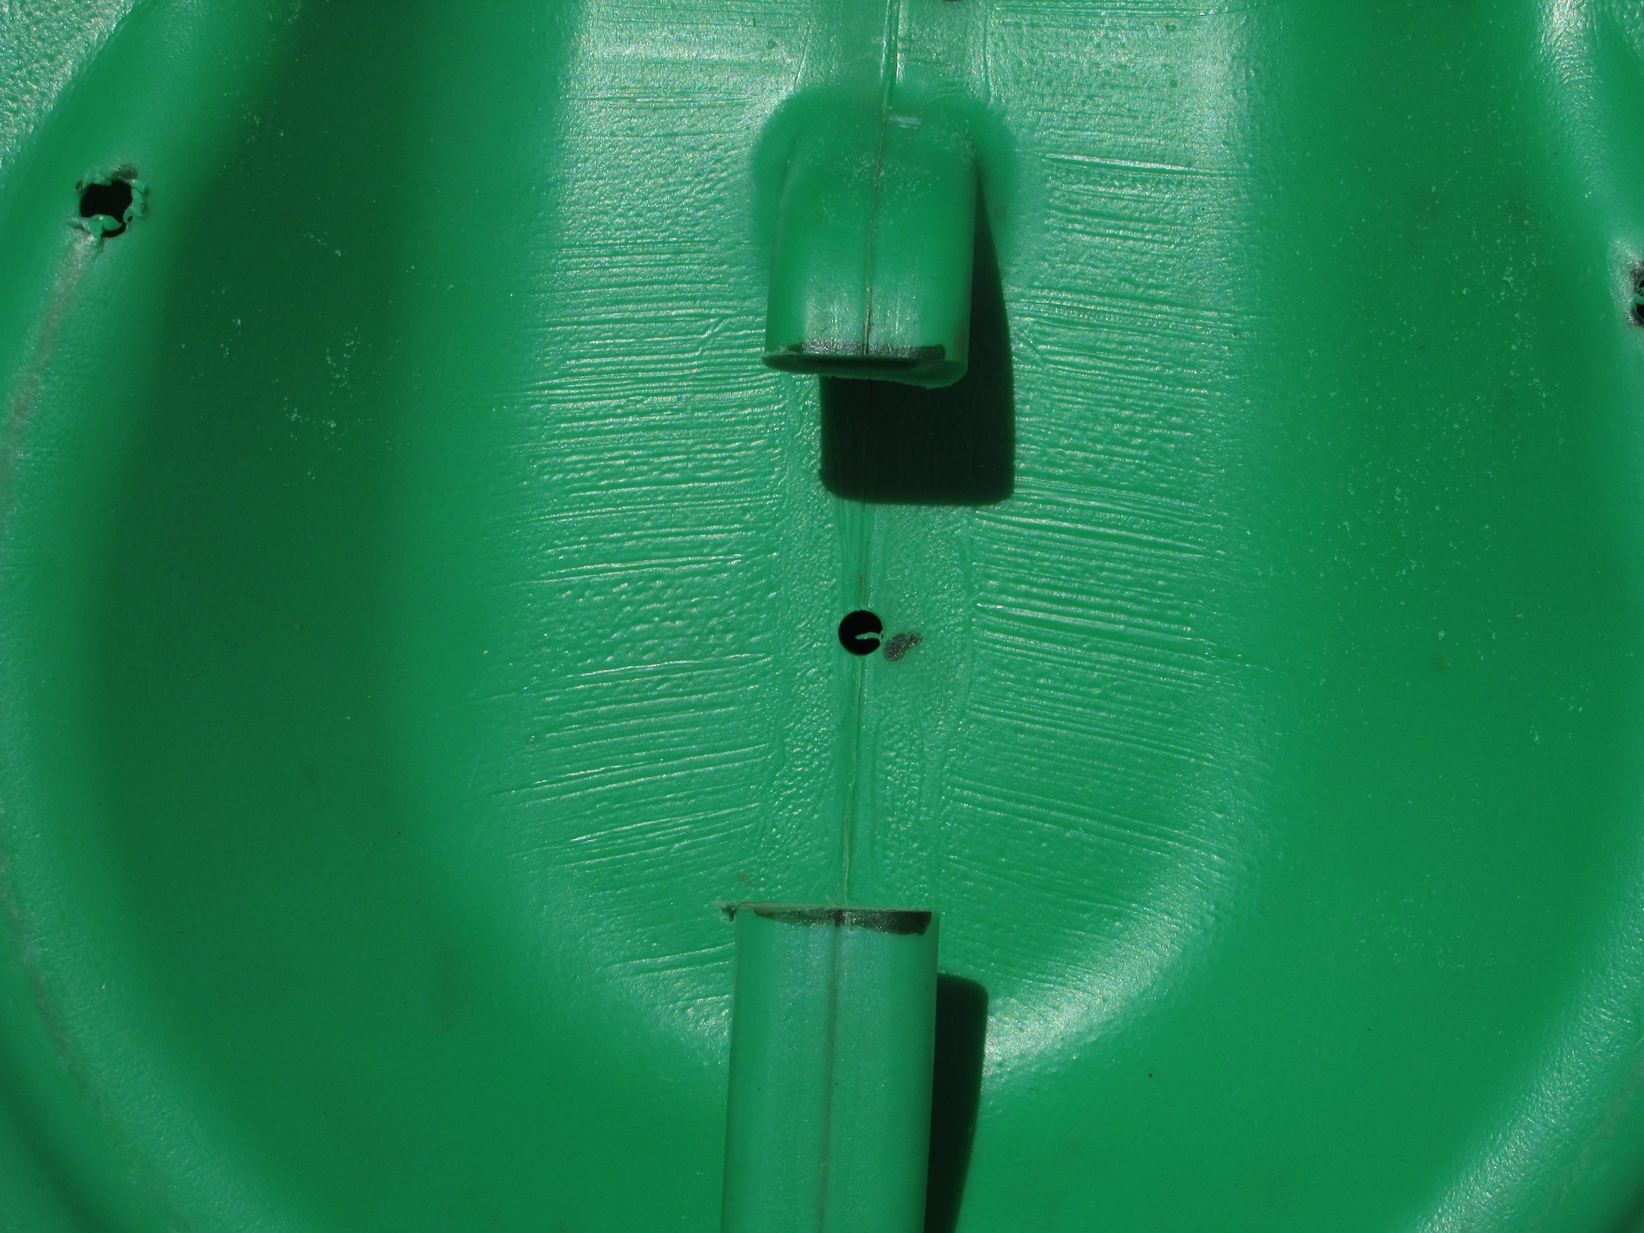
5 mm

Slide 9
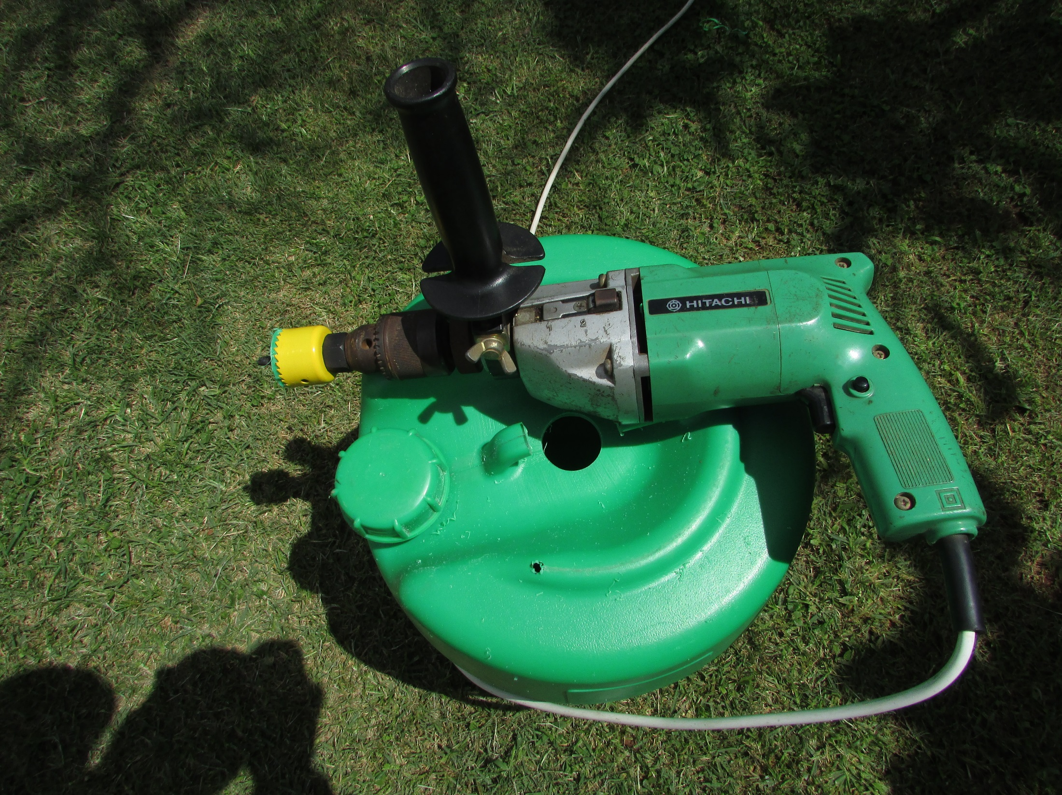
Drill a hole for the
irrigation bottle.
38 mm

Slide 10
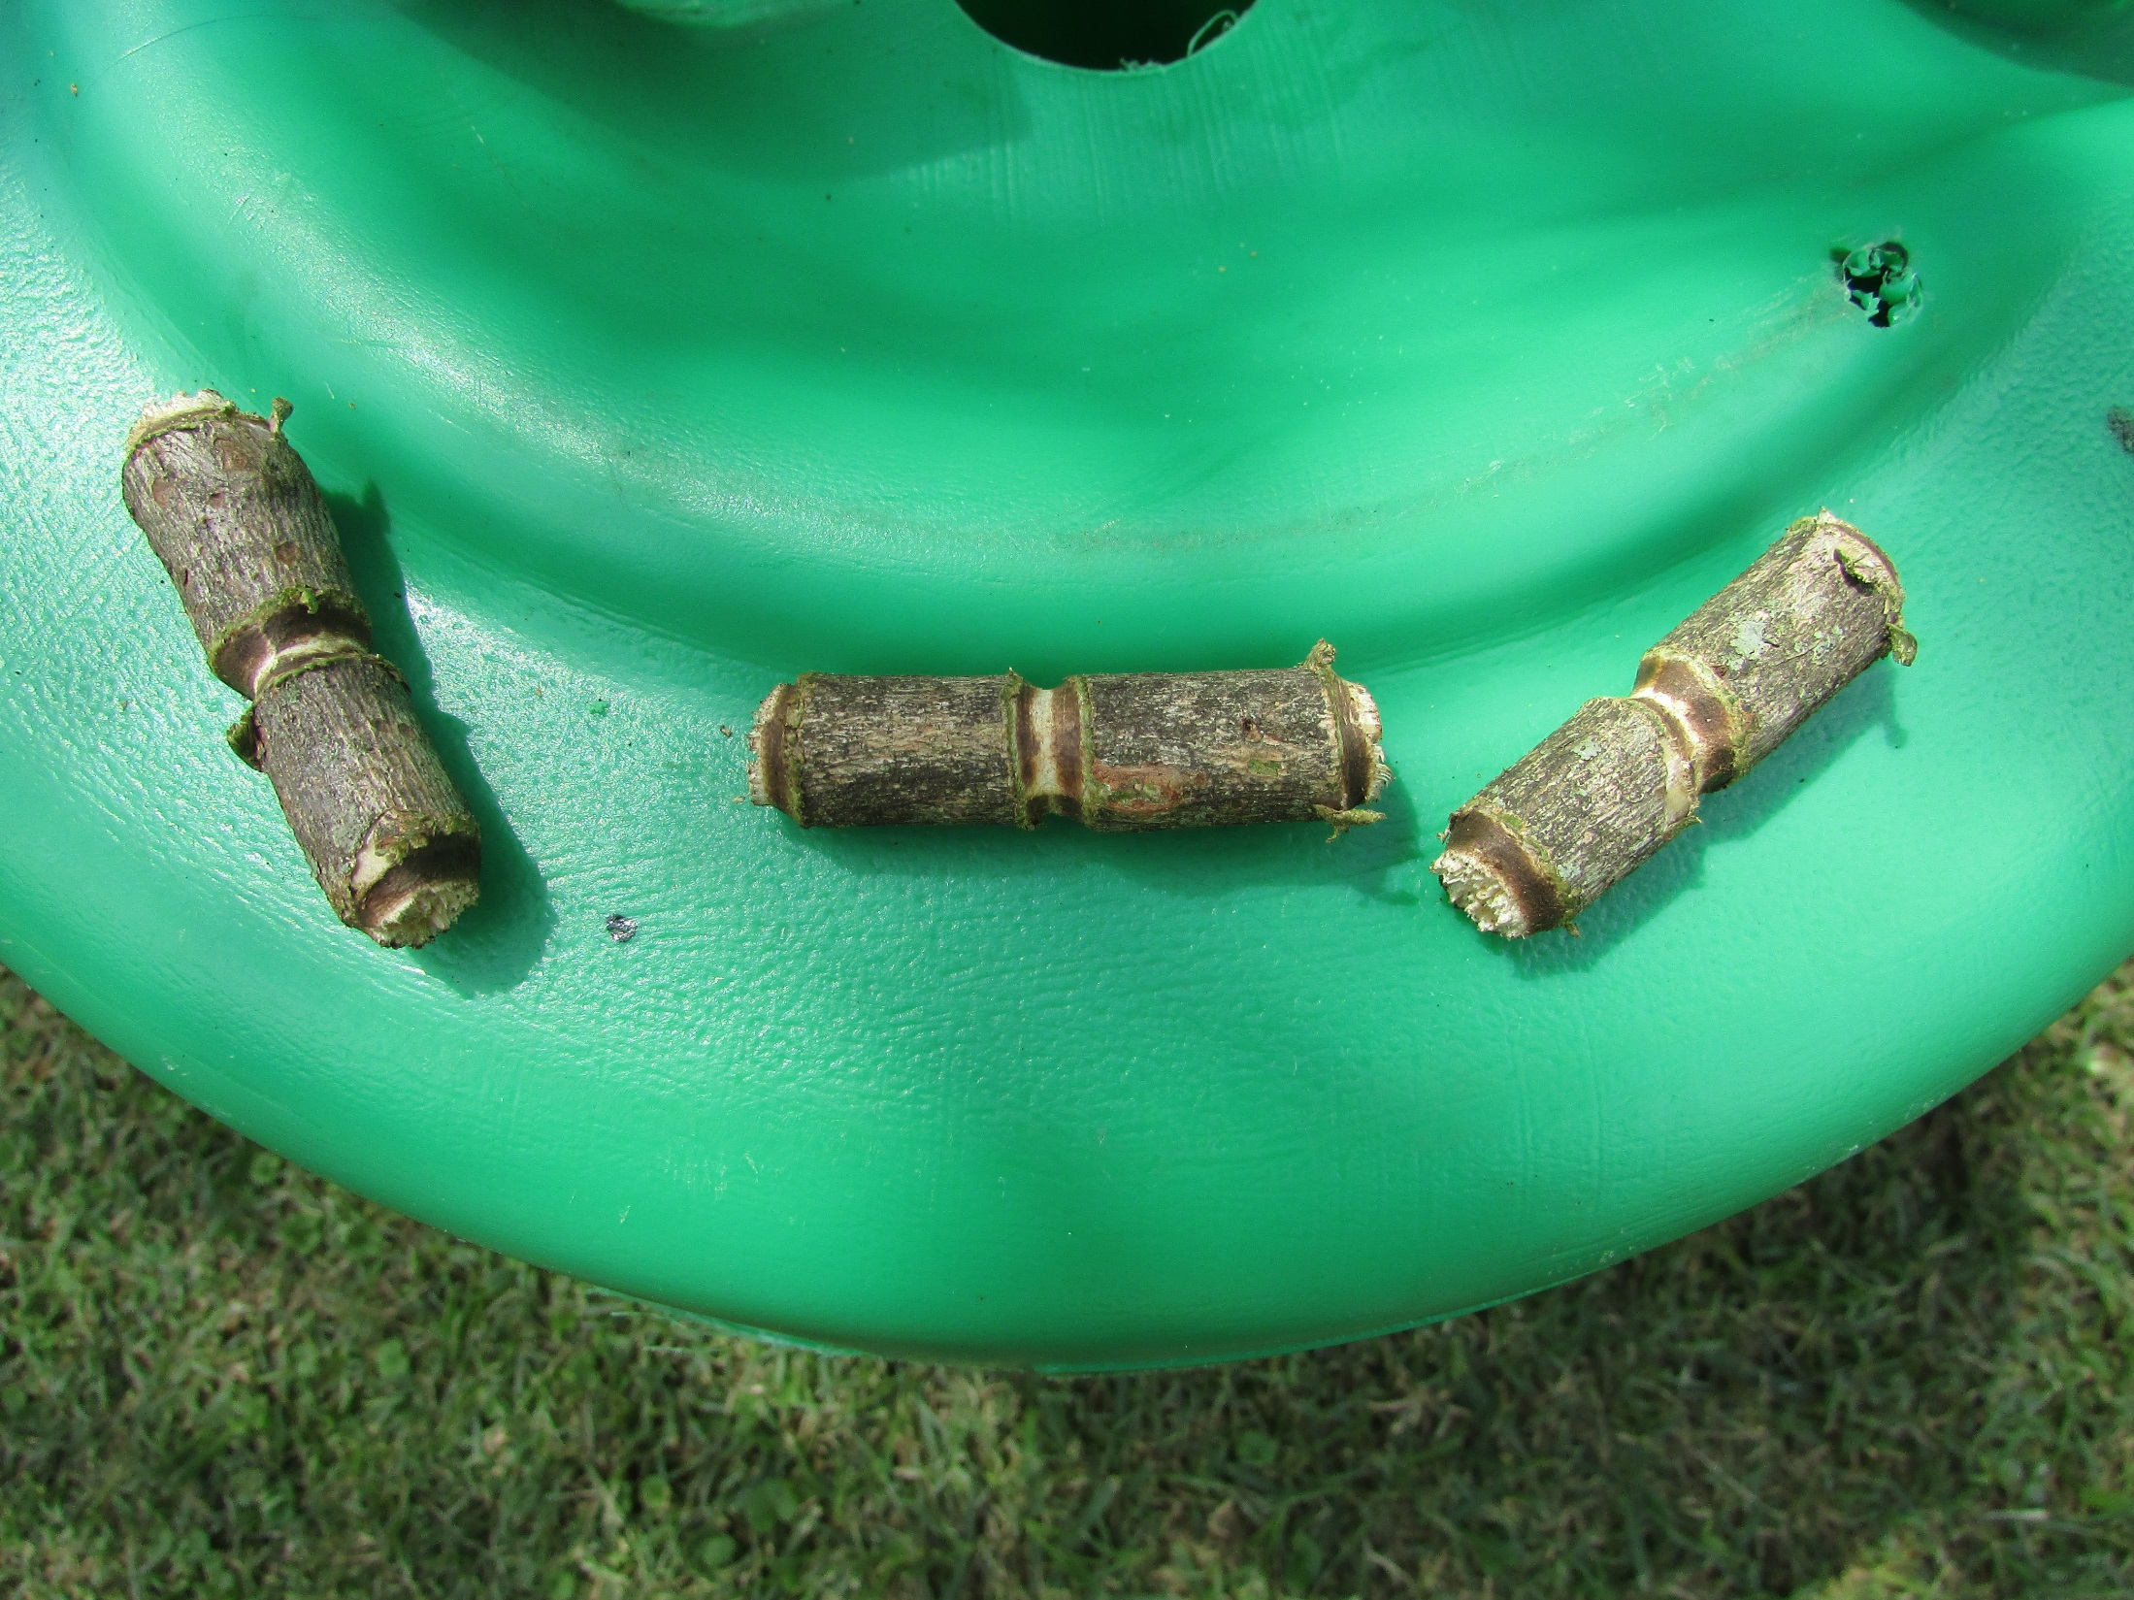
Making the handle
3 X toggles

Slide 11
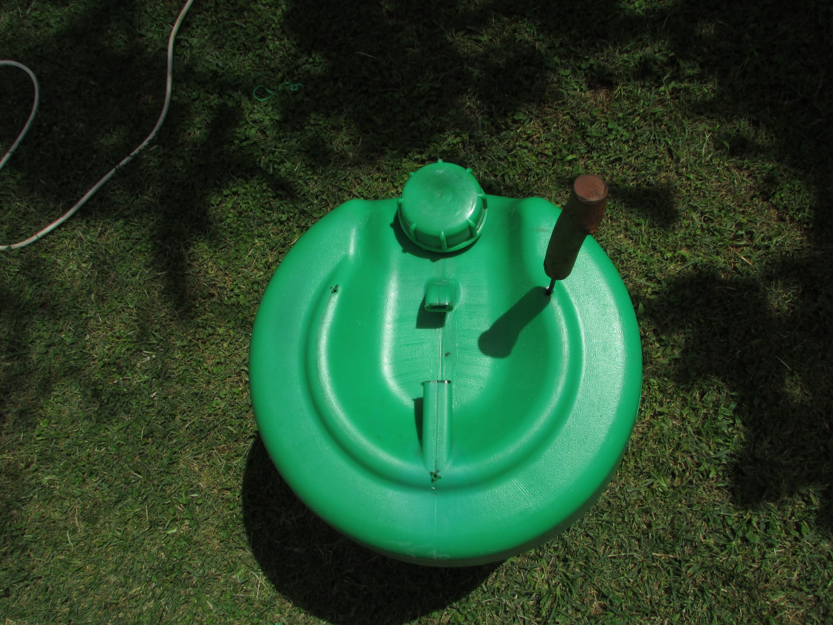
Mark three holes
for handle cords

Slide 12
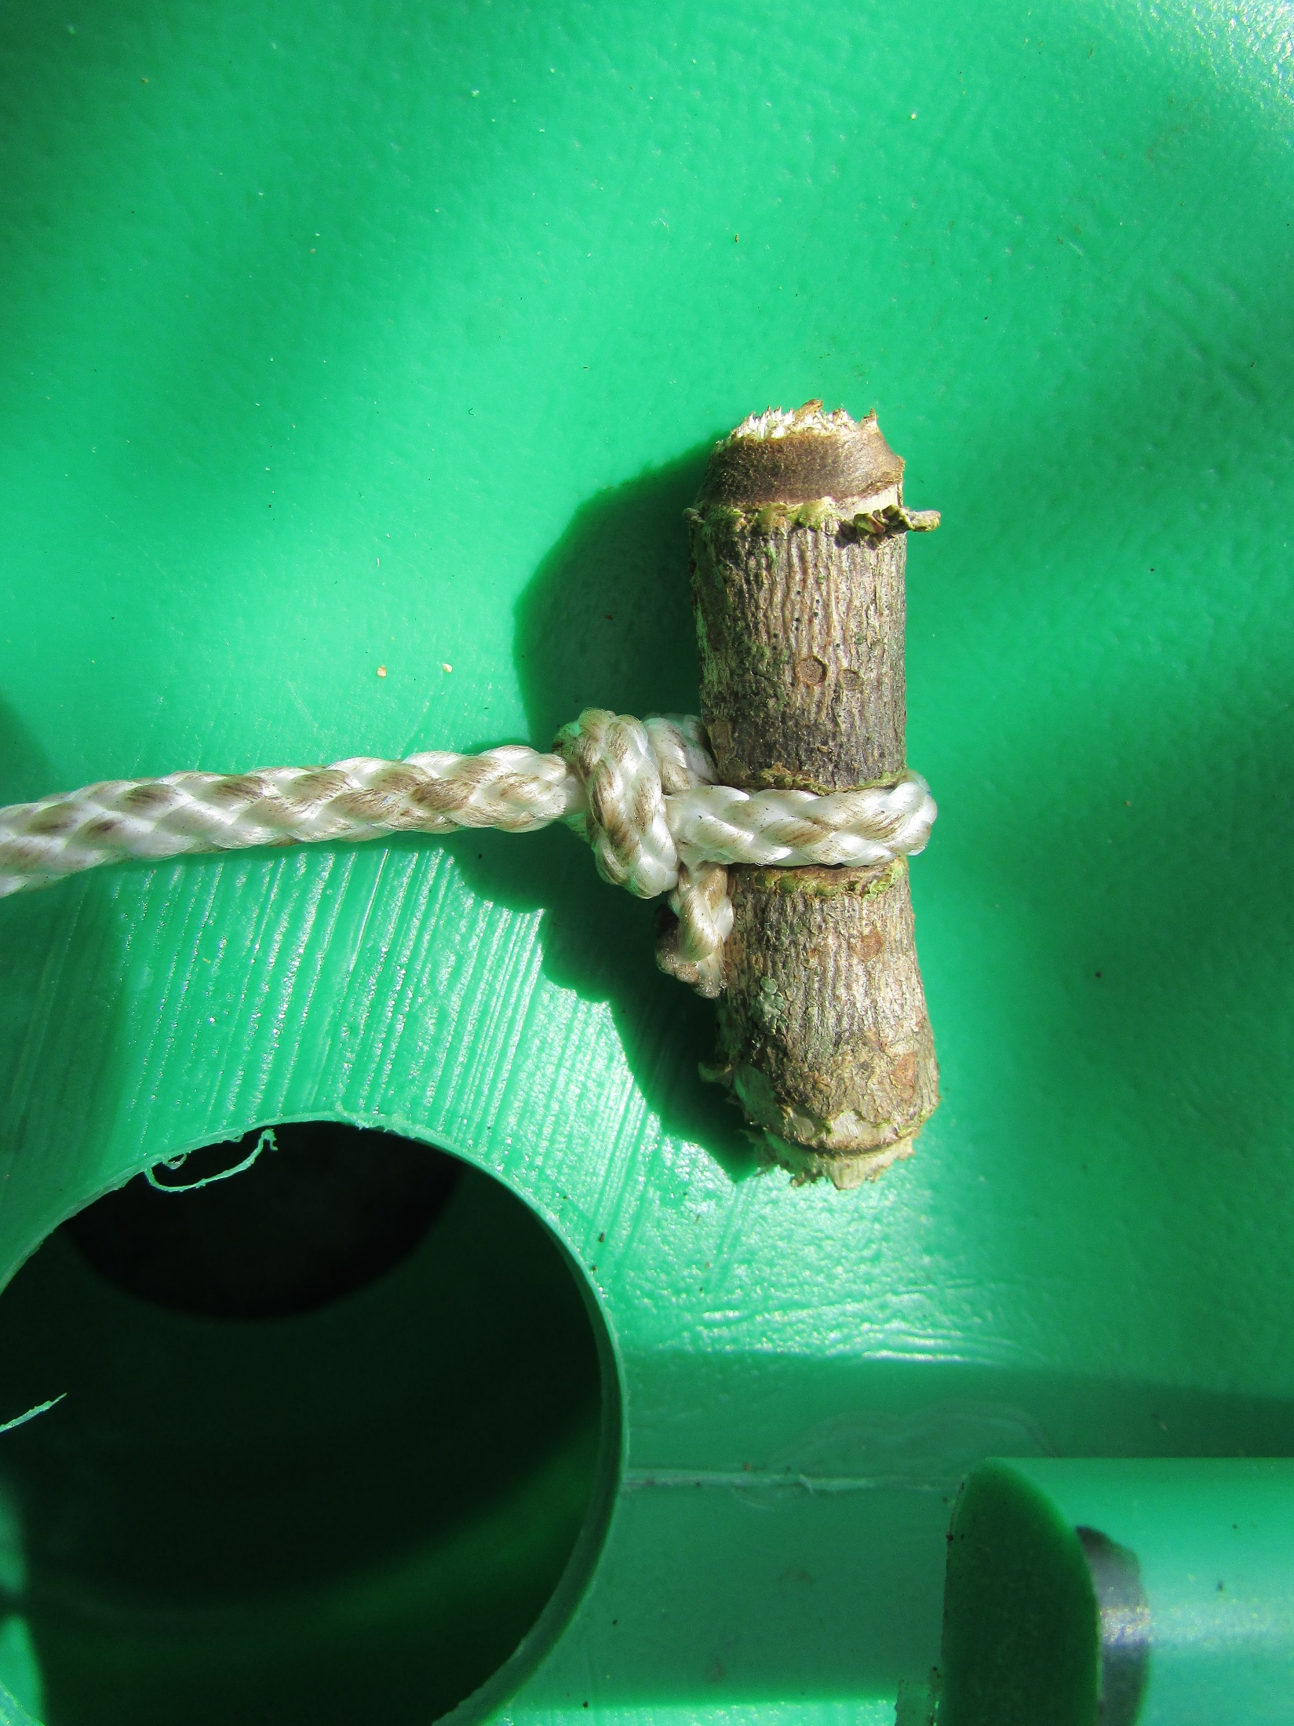

Slide 13
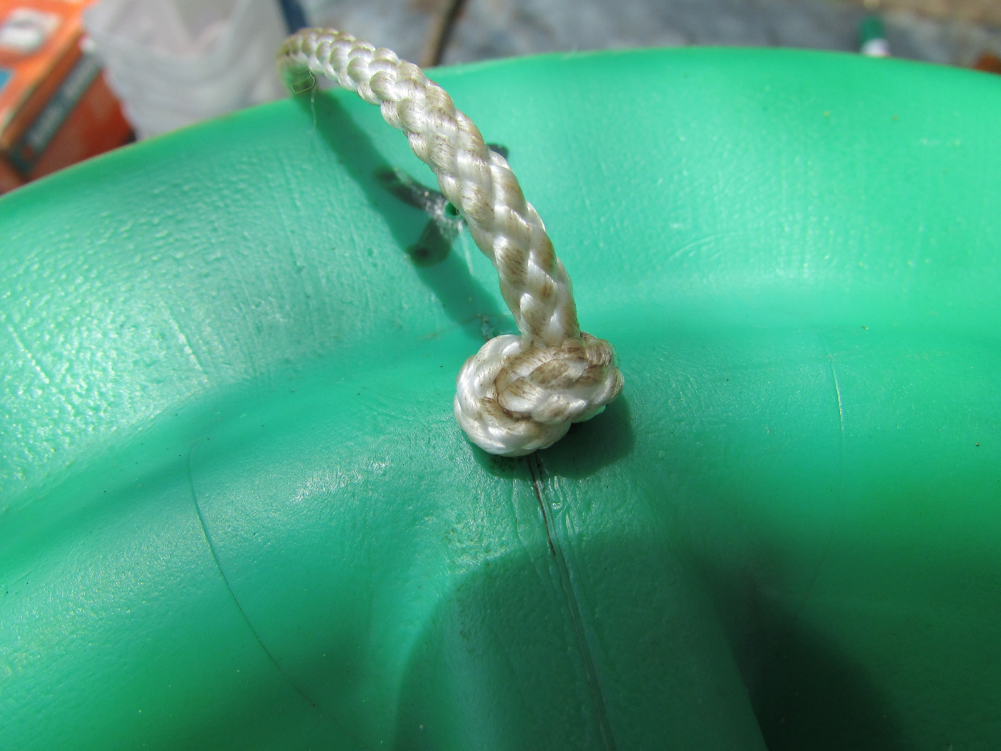
Toggle on inside of container

Slide 14
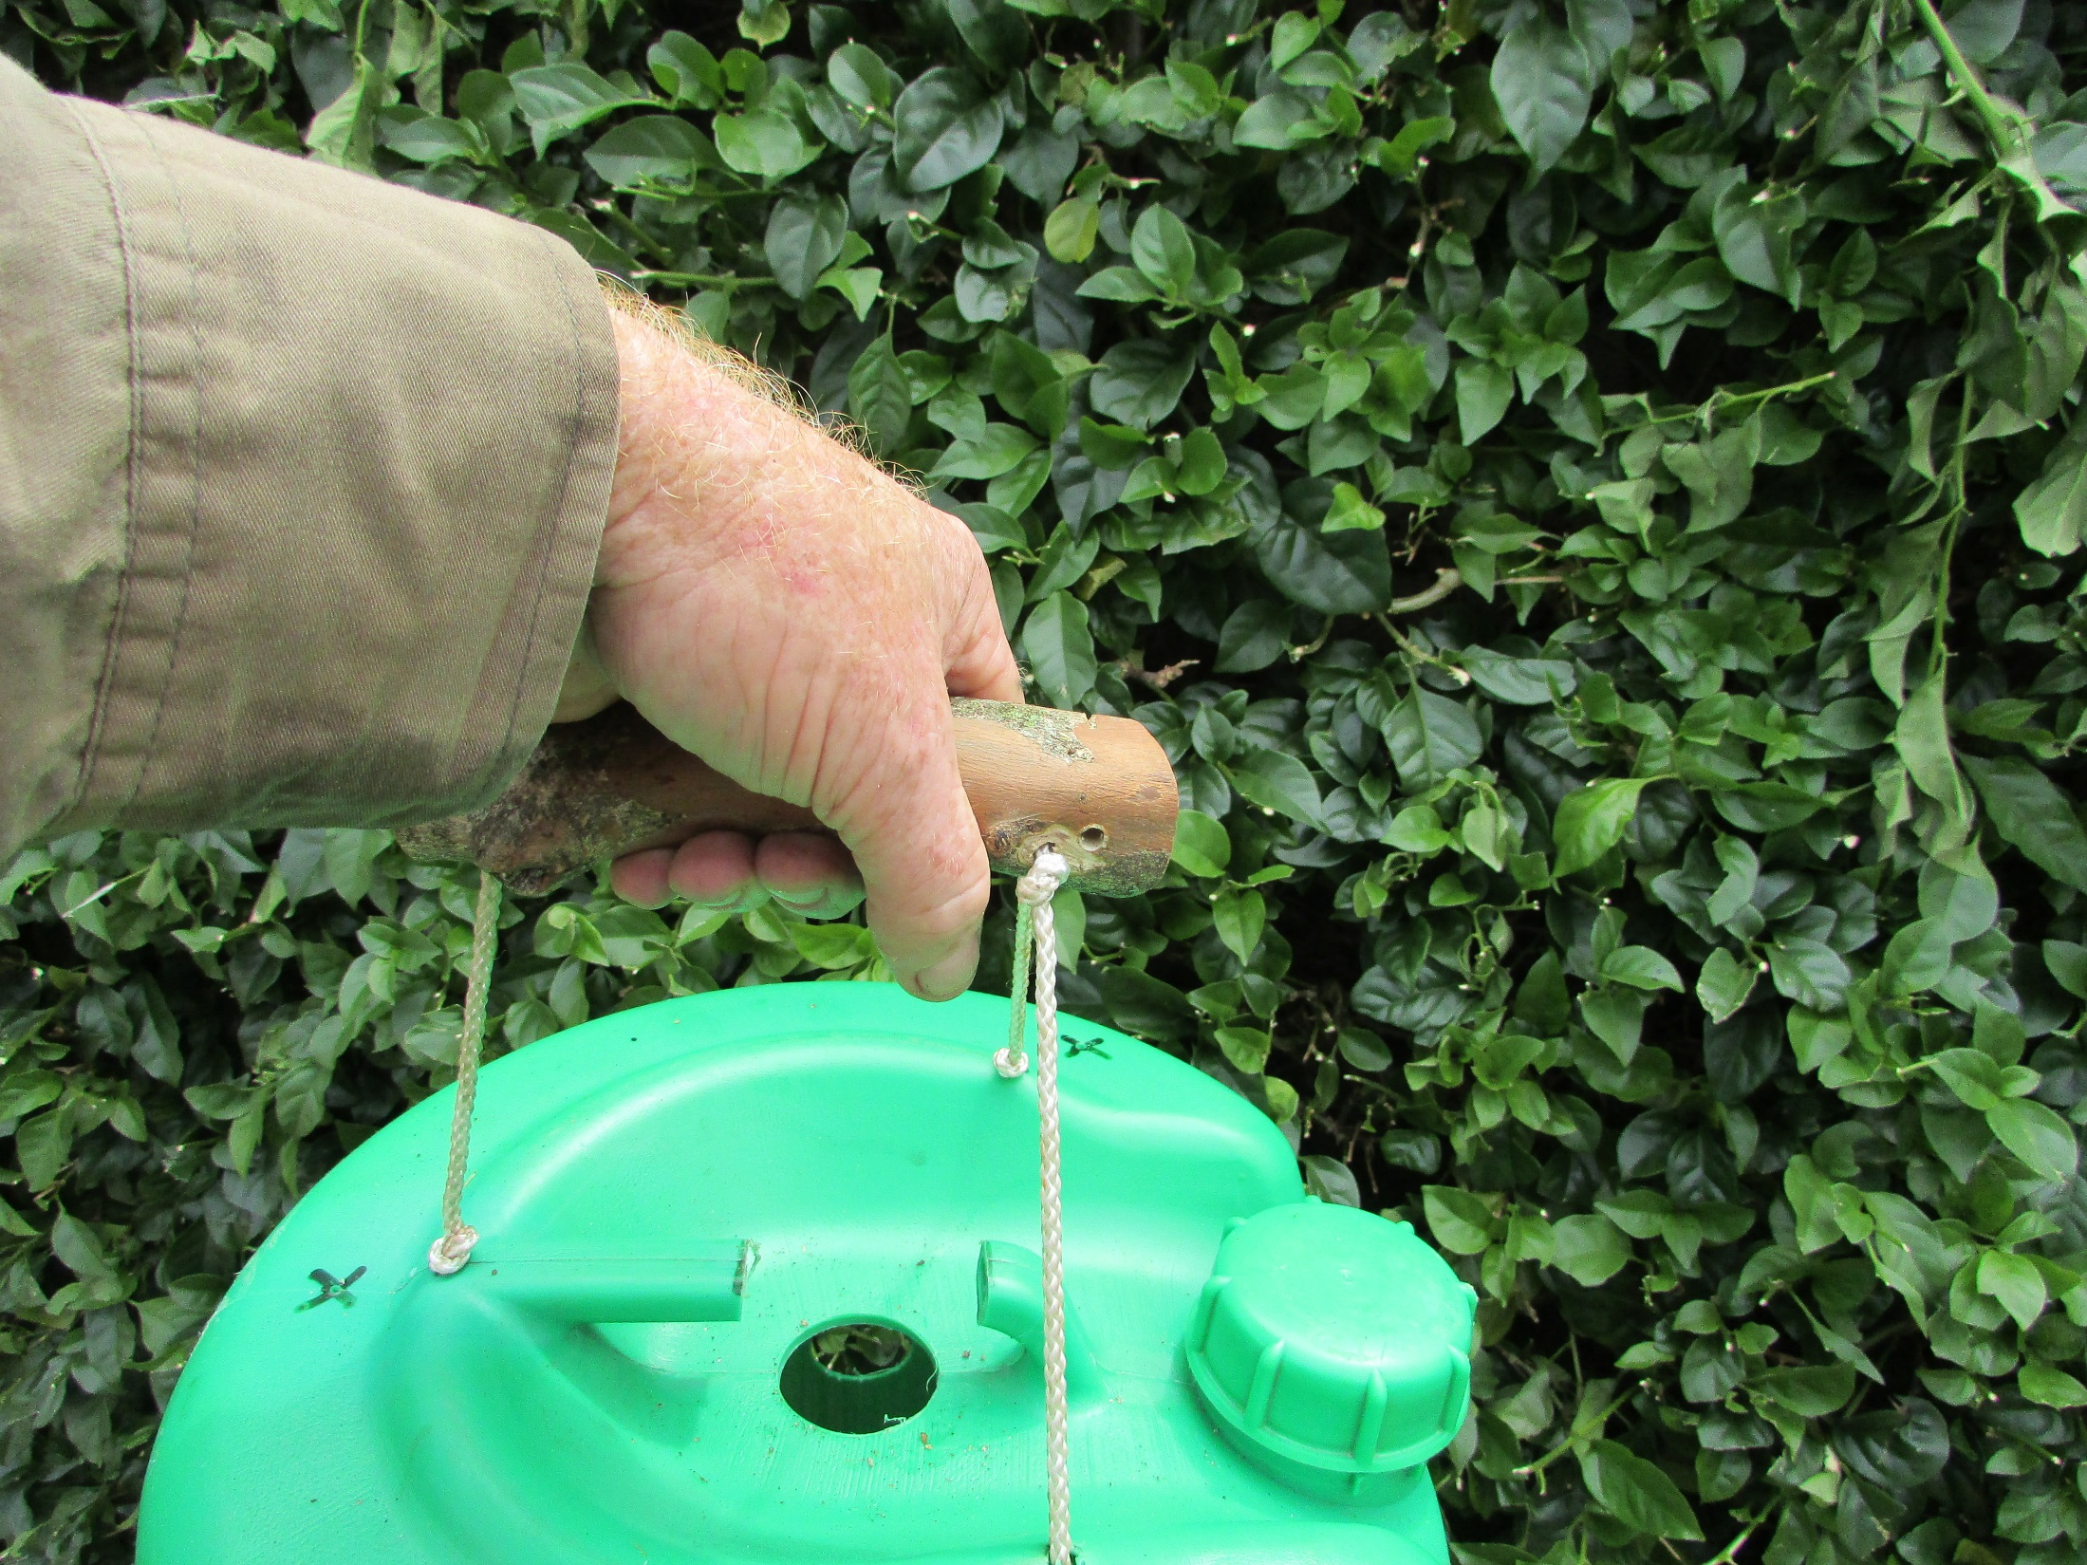
Attach a balanced handle

Slide 15
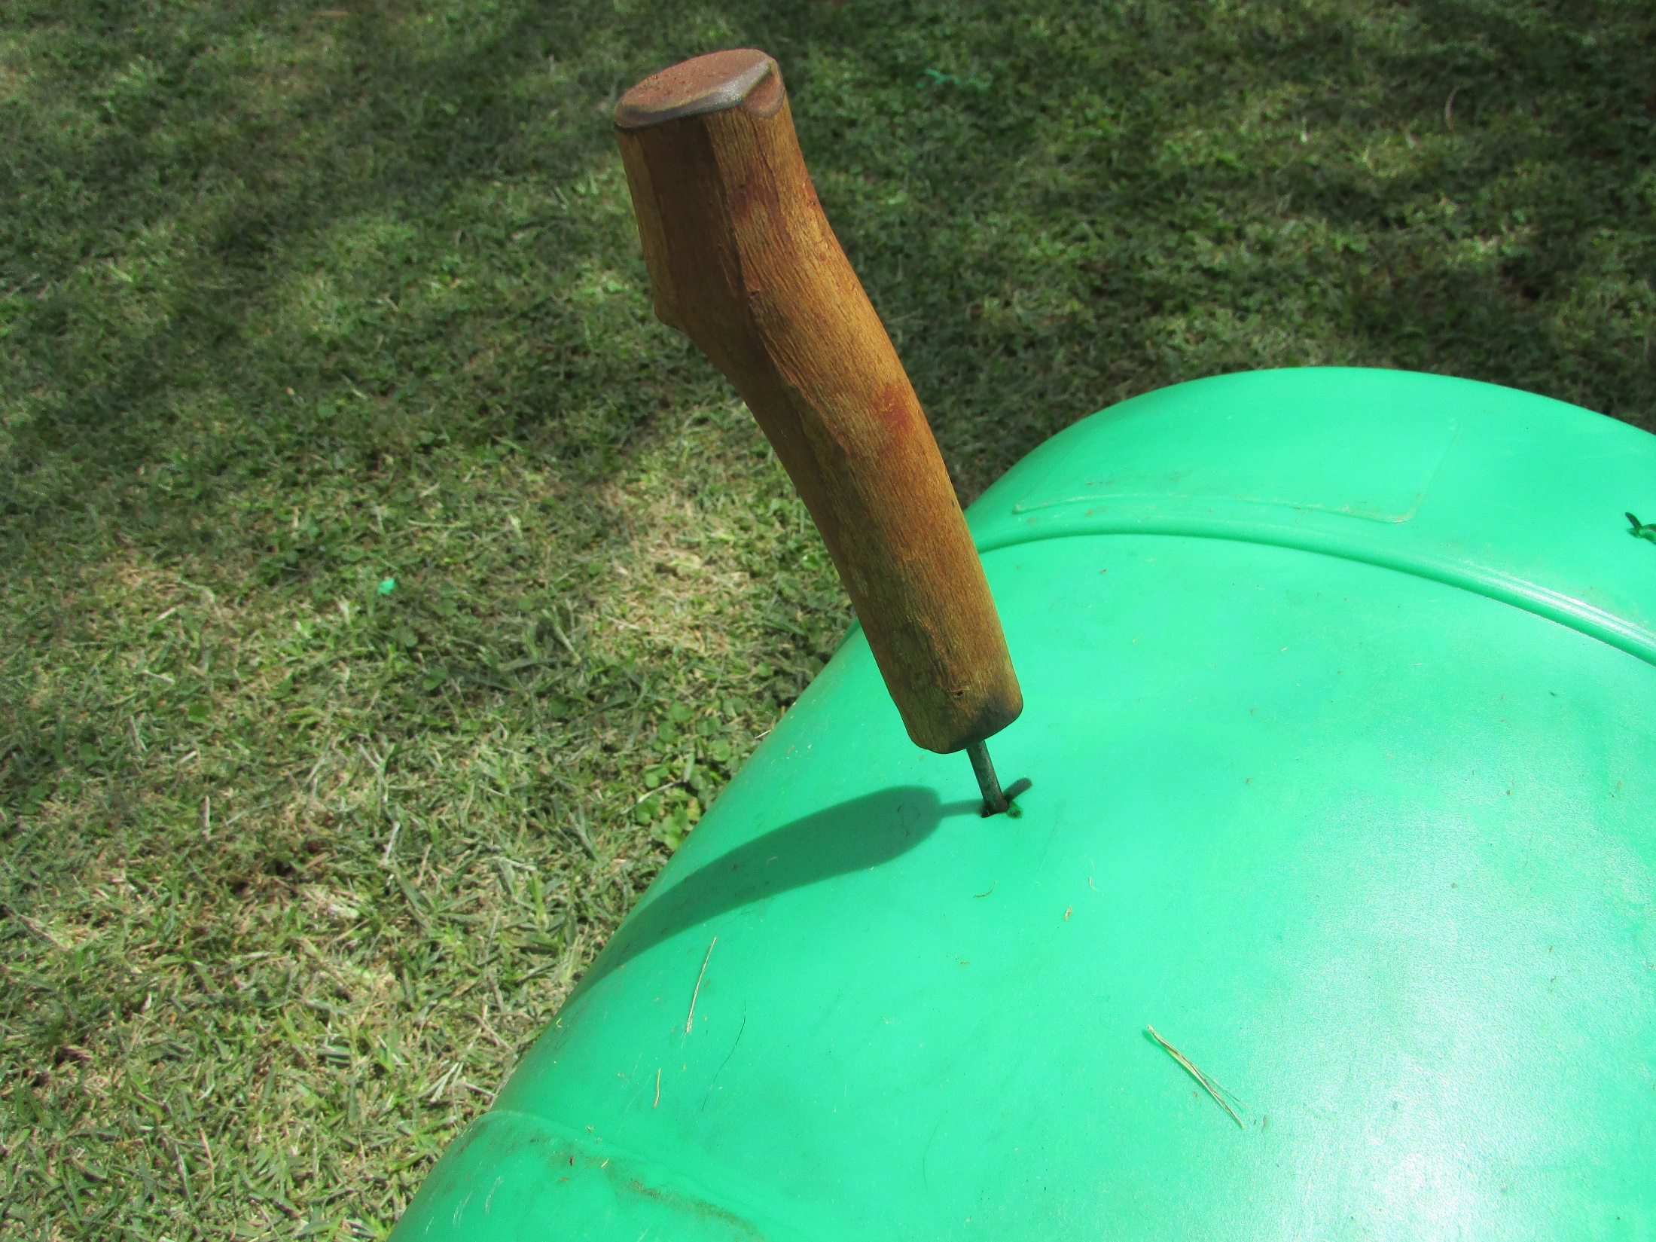
Mark plant stations

Slide 16
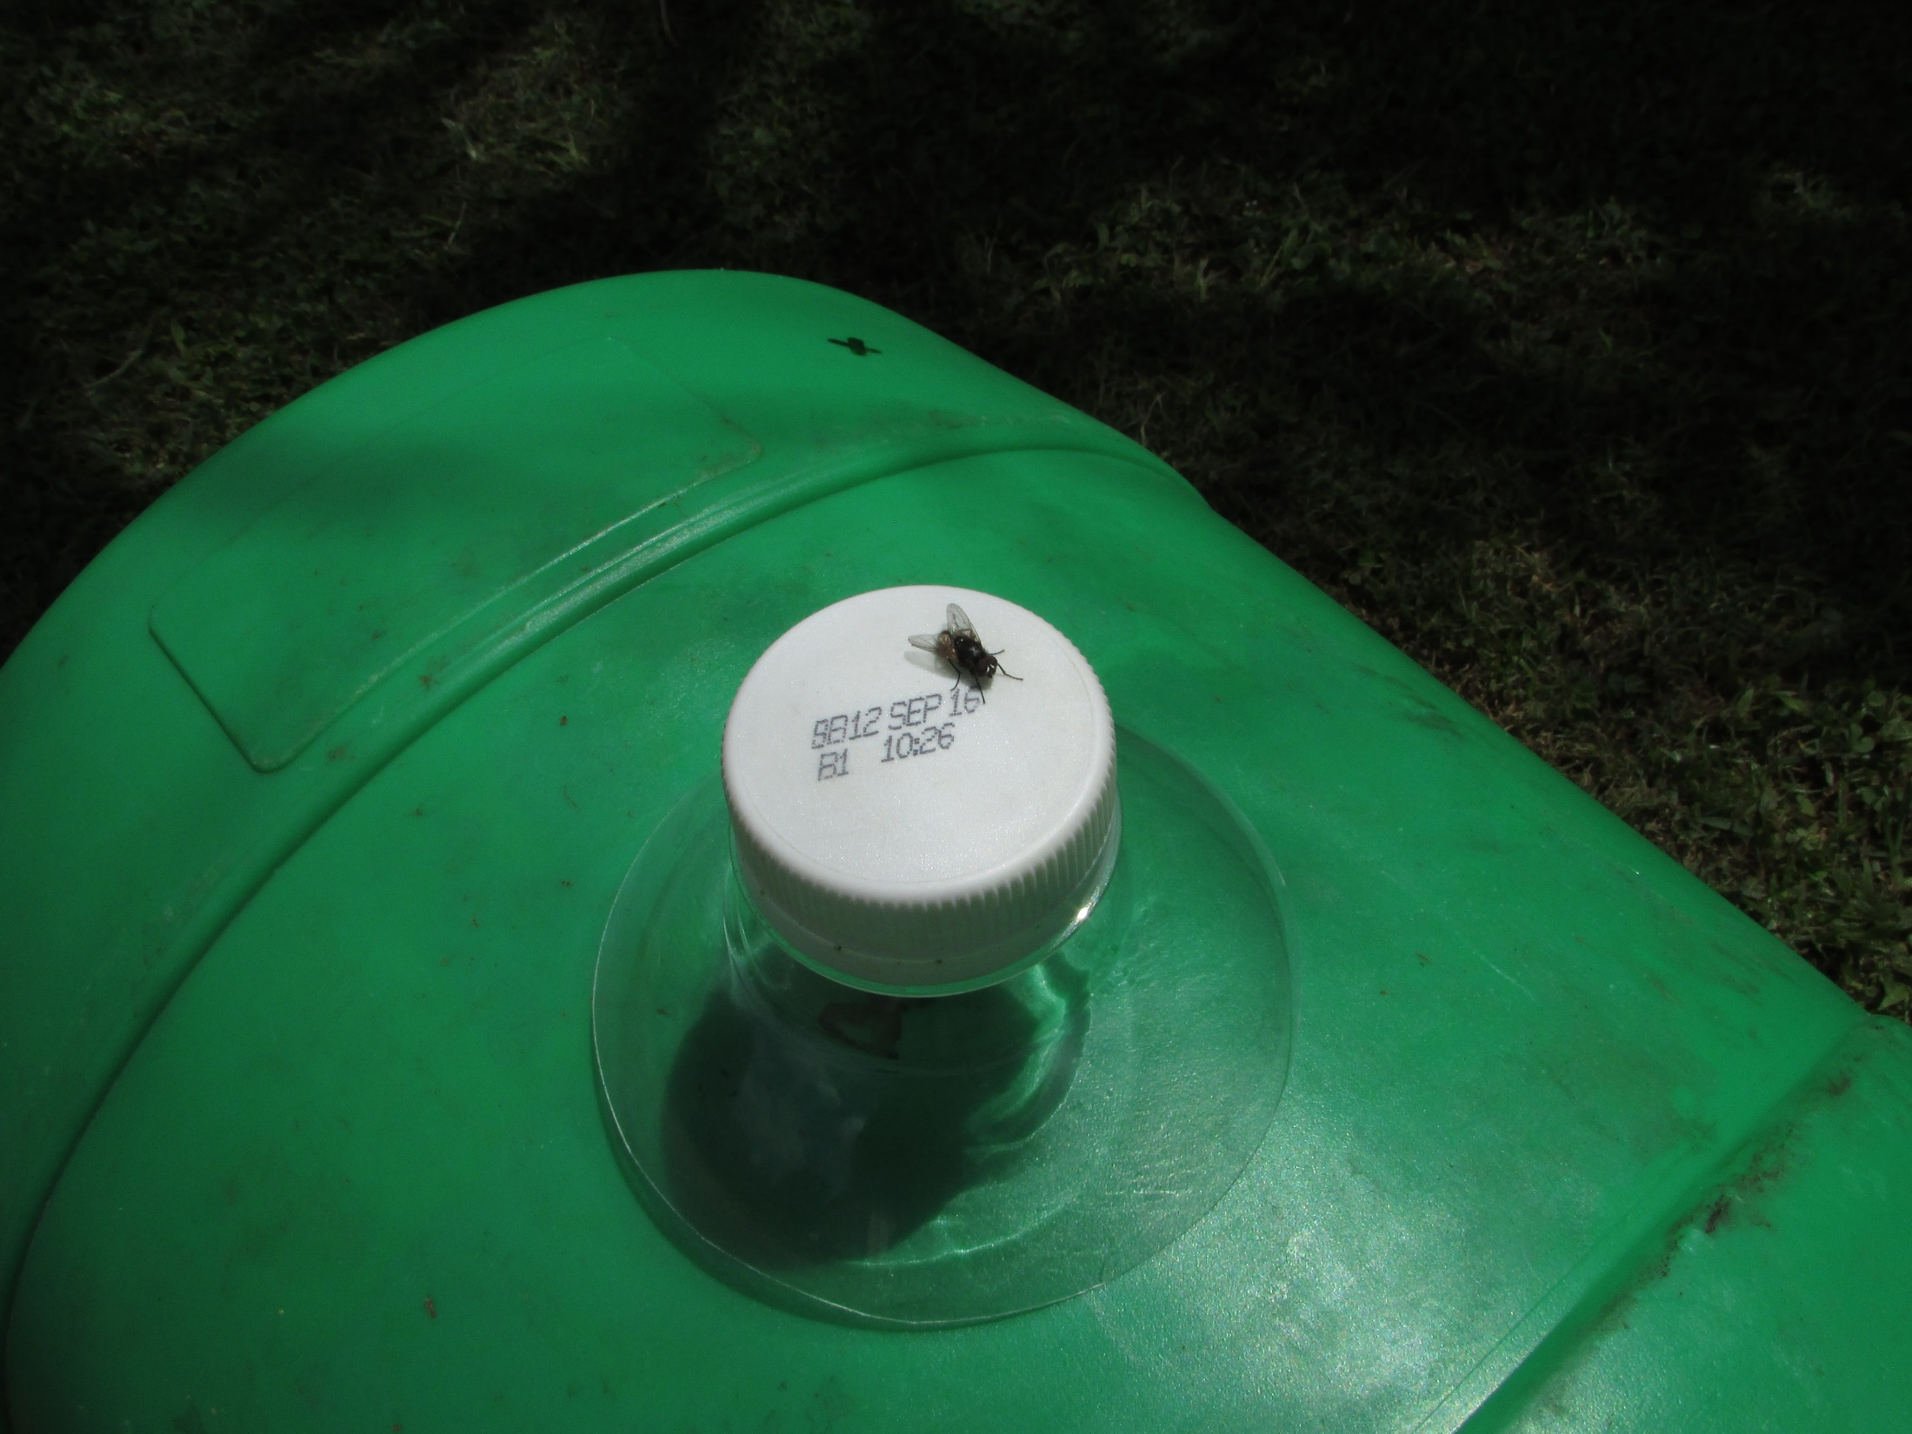
Trim bottle necks

Slide 17
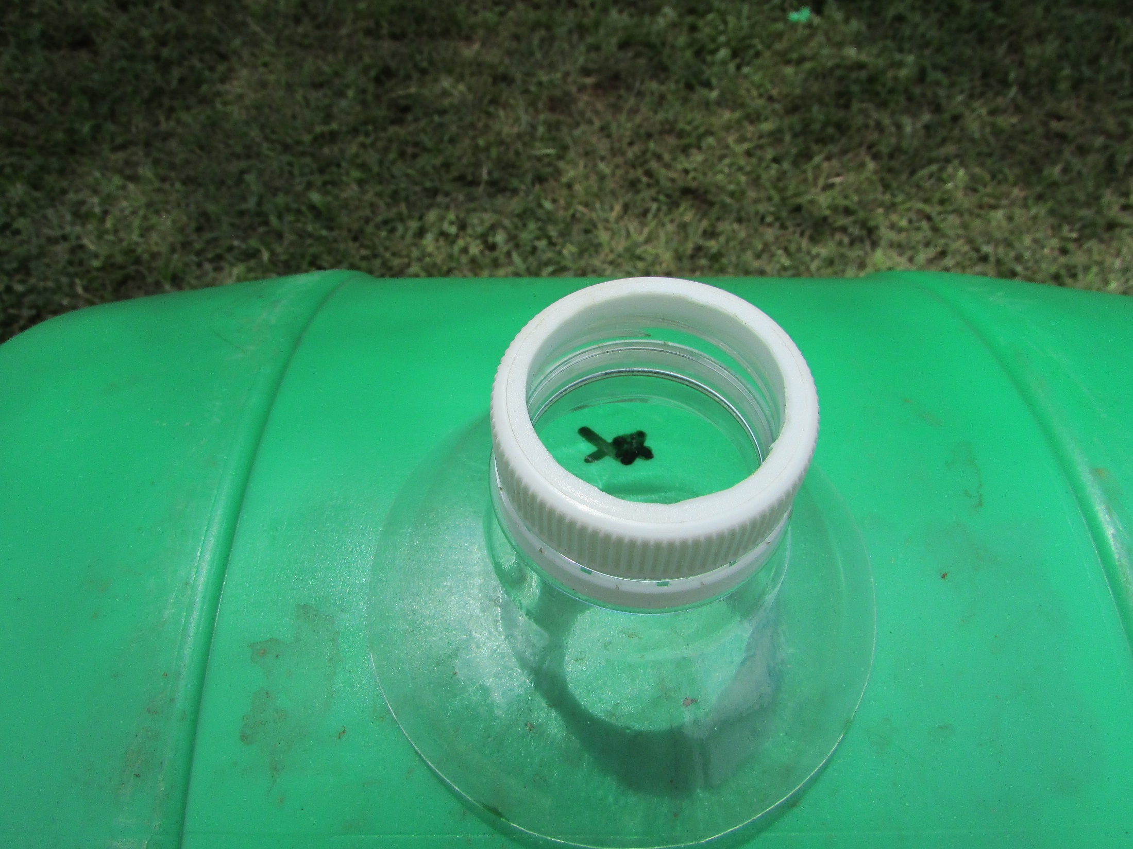
Cut out top with knife

Slide 18
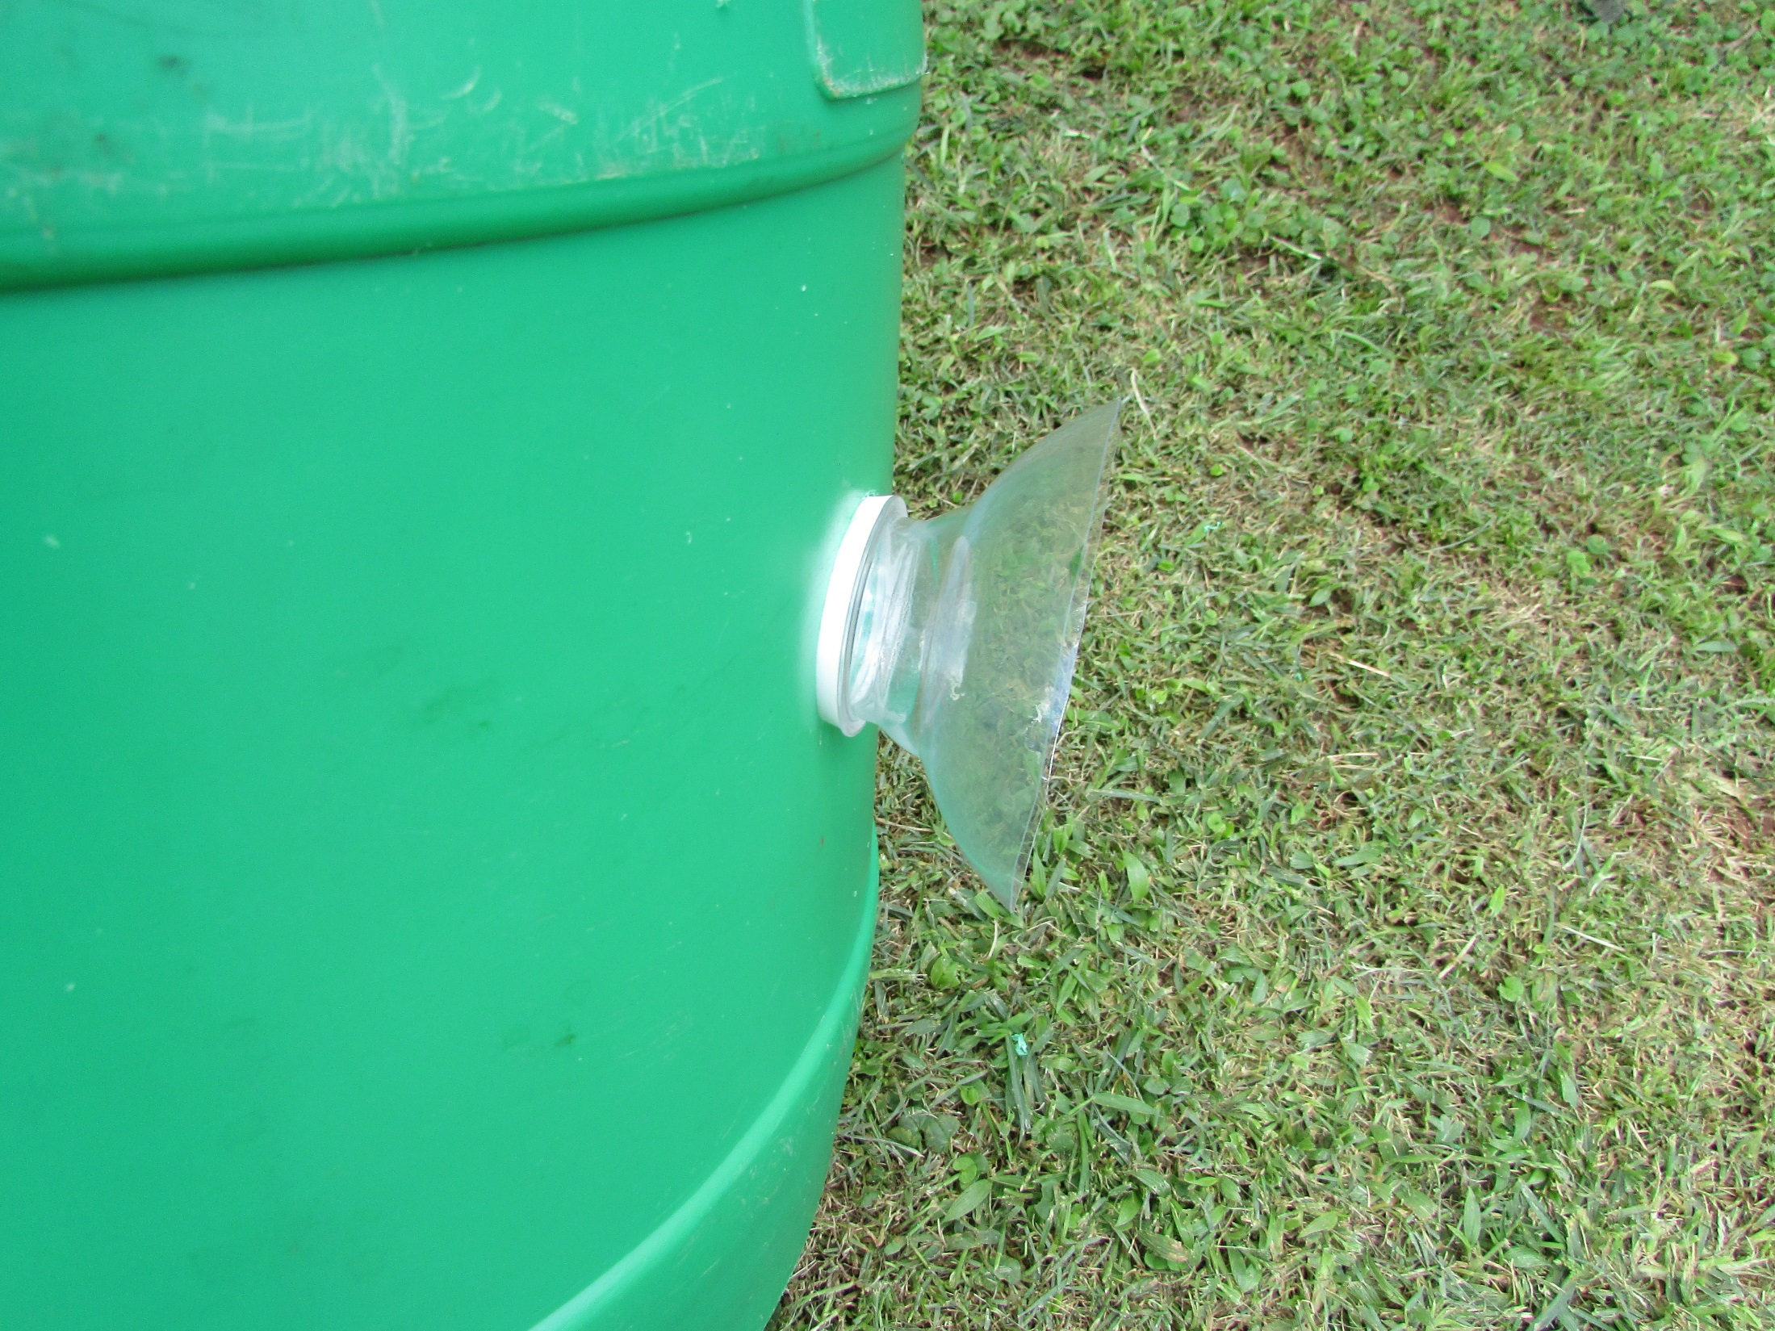
Screw in bottle neck
planting stations

Slide 19
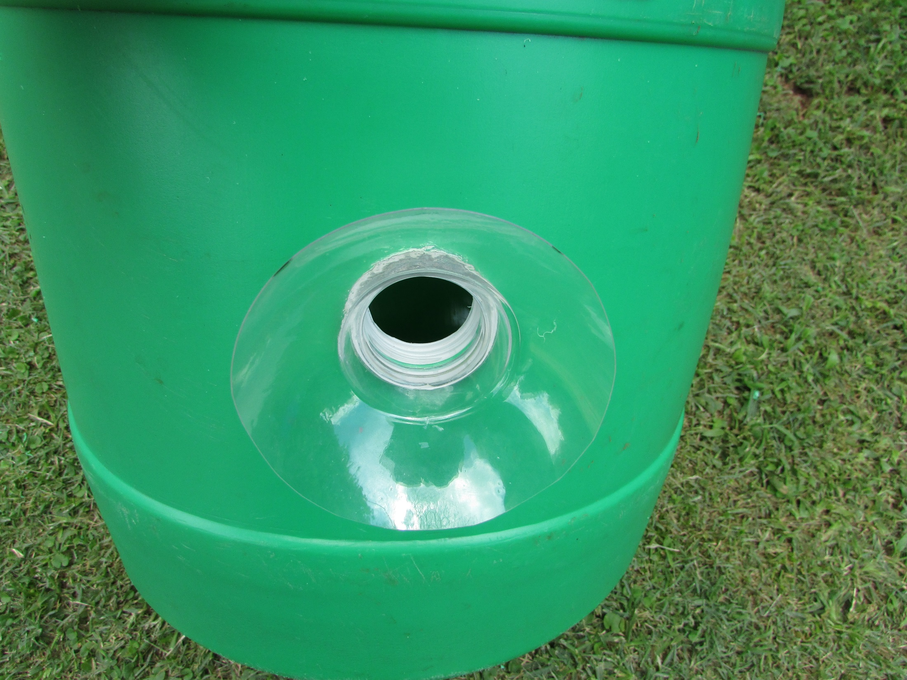

Slide 20
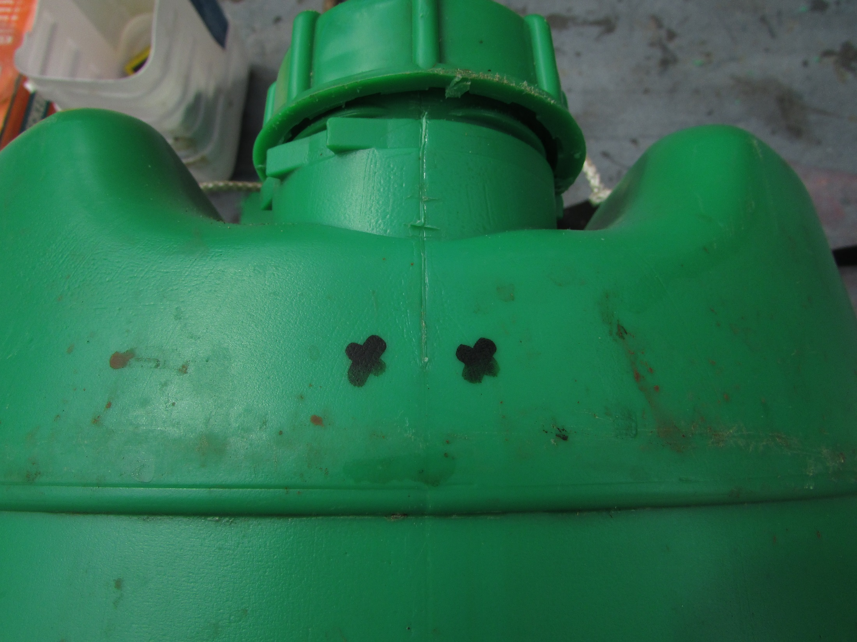
Mark out holes for
tomato stake lashings

Slide 21
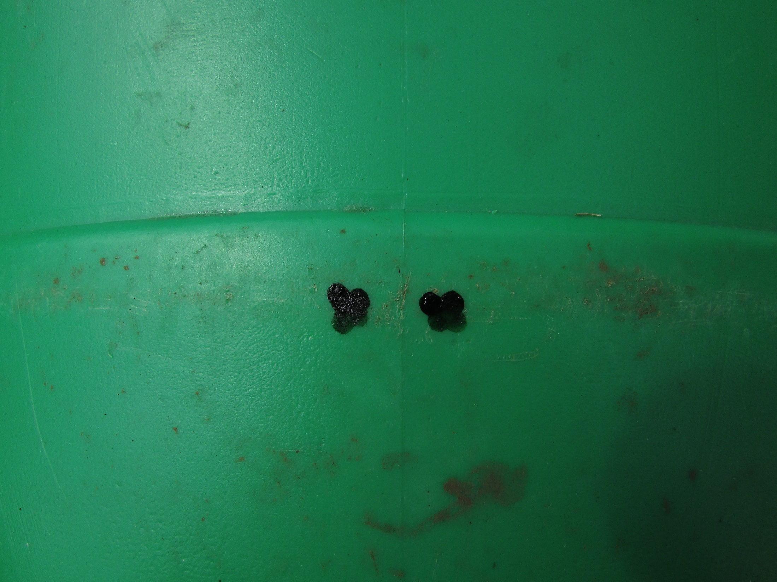
Top and bottom

Slide 22
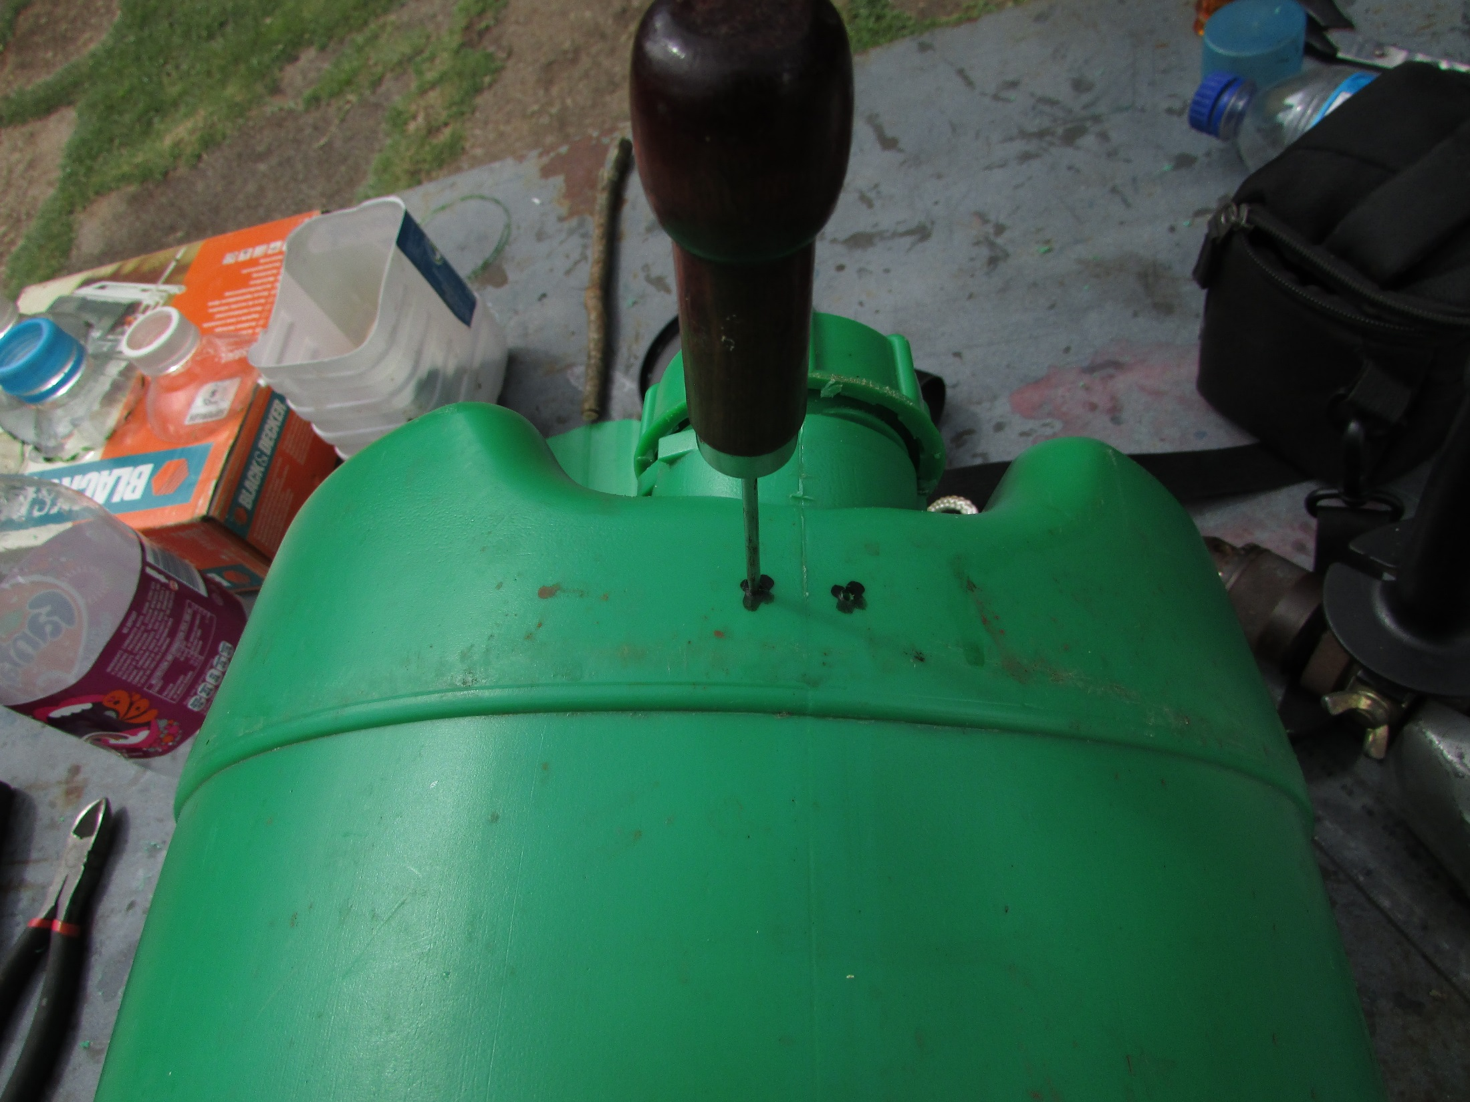
Punch guide holes

Slide 23
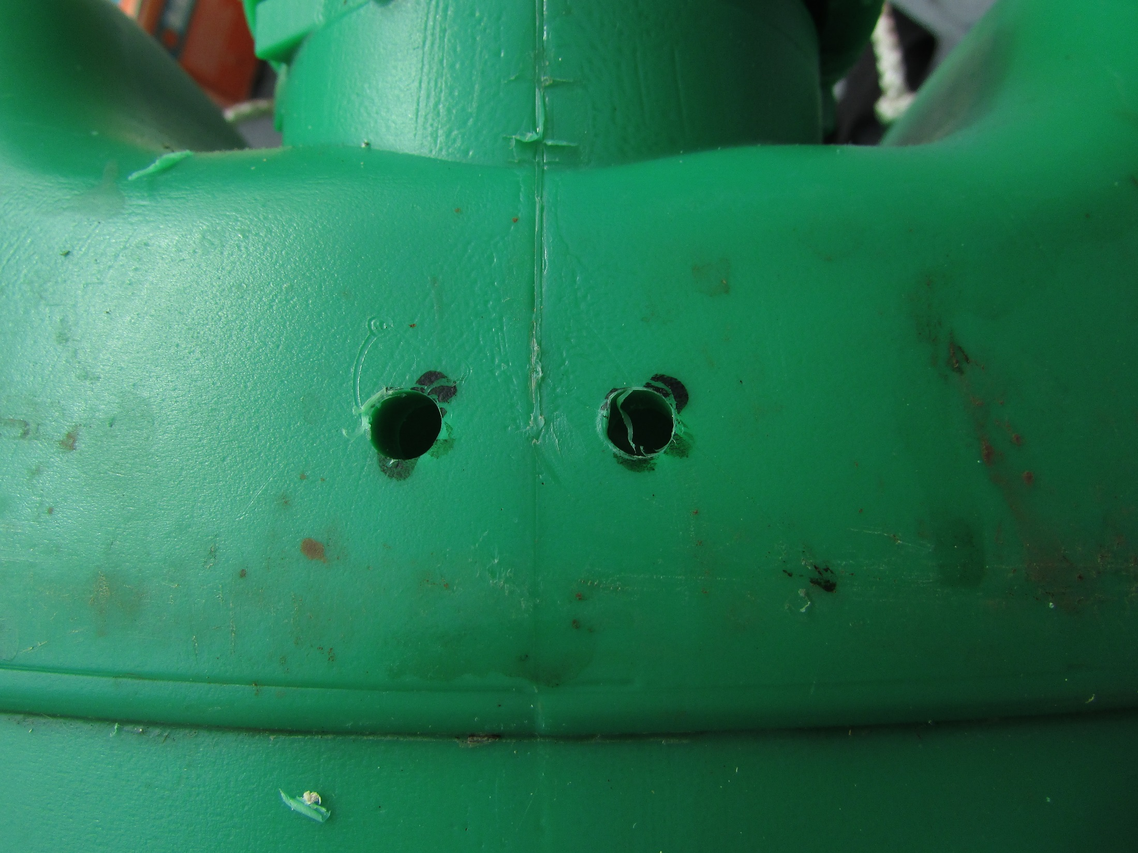
Drill 5 mm

Slide 24
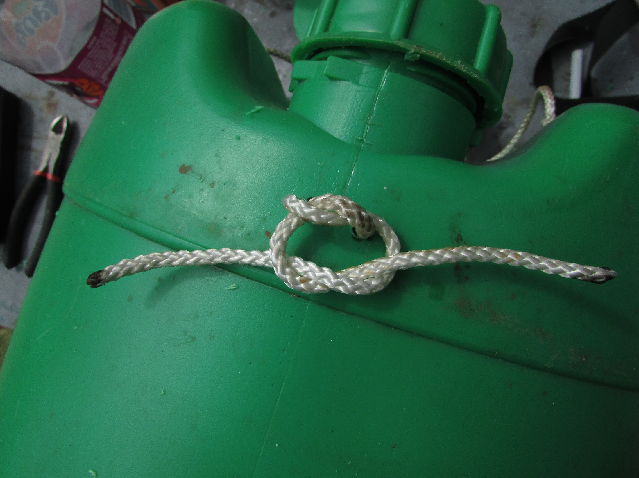
Prepare cords to hold stake

Slide 25
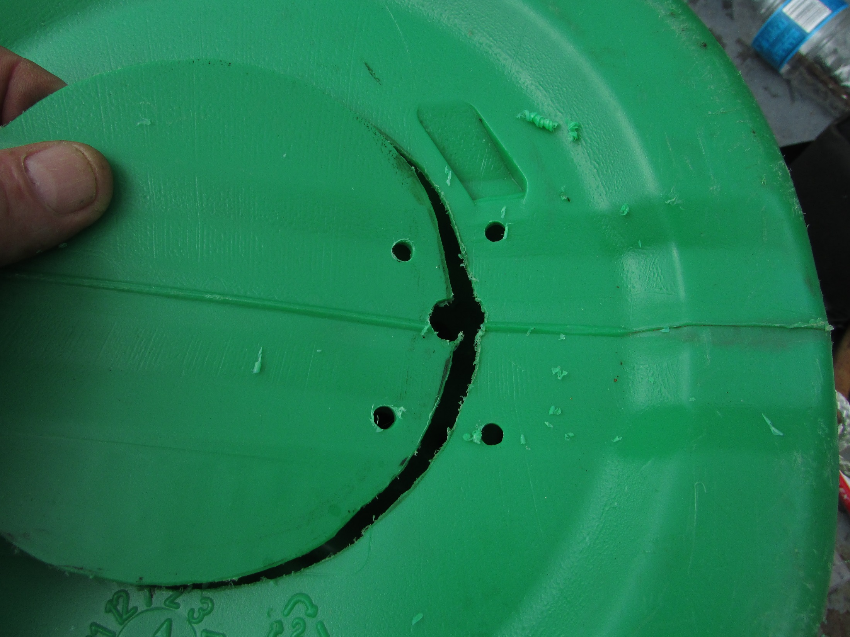
Drill 5 mm holes
for cord hinges

Slide 26
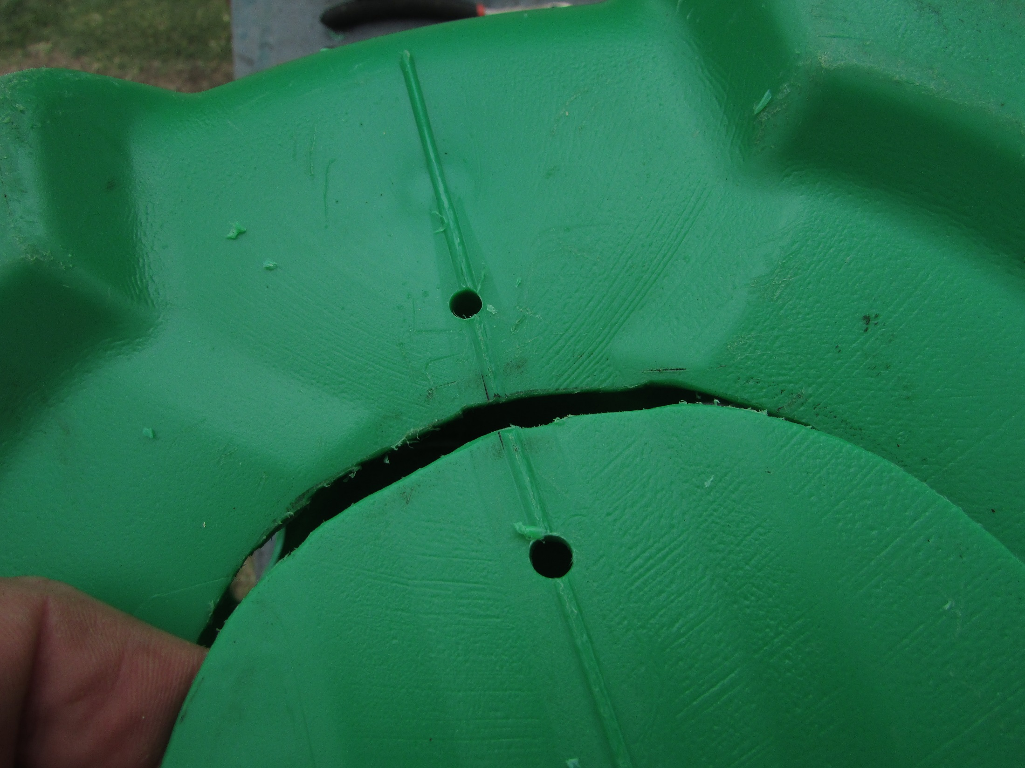
Holes for the latch

Slide 27
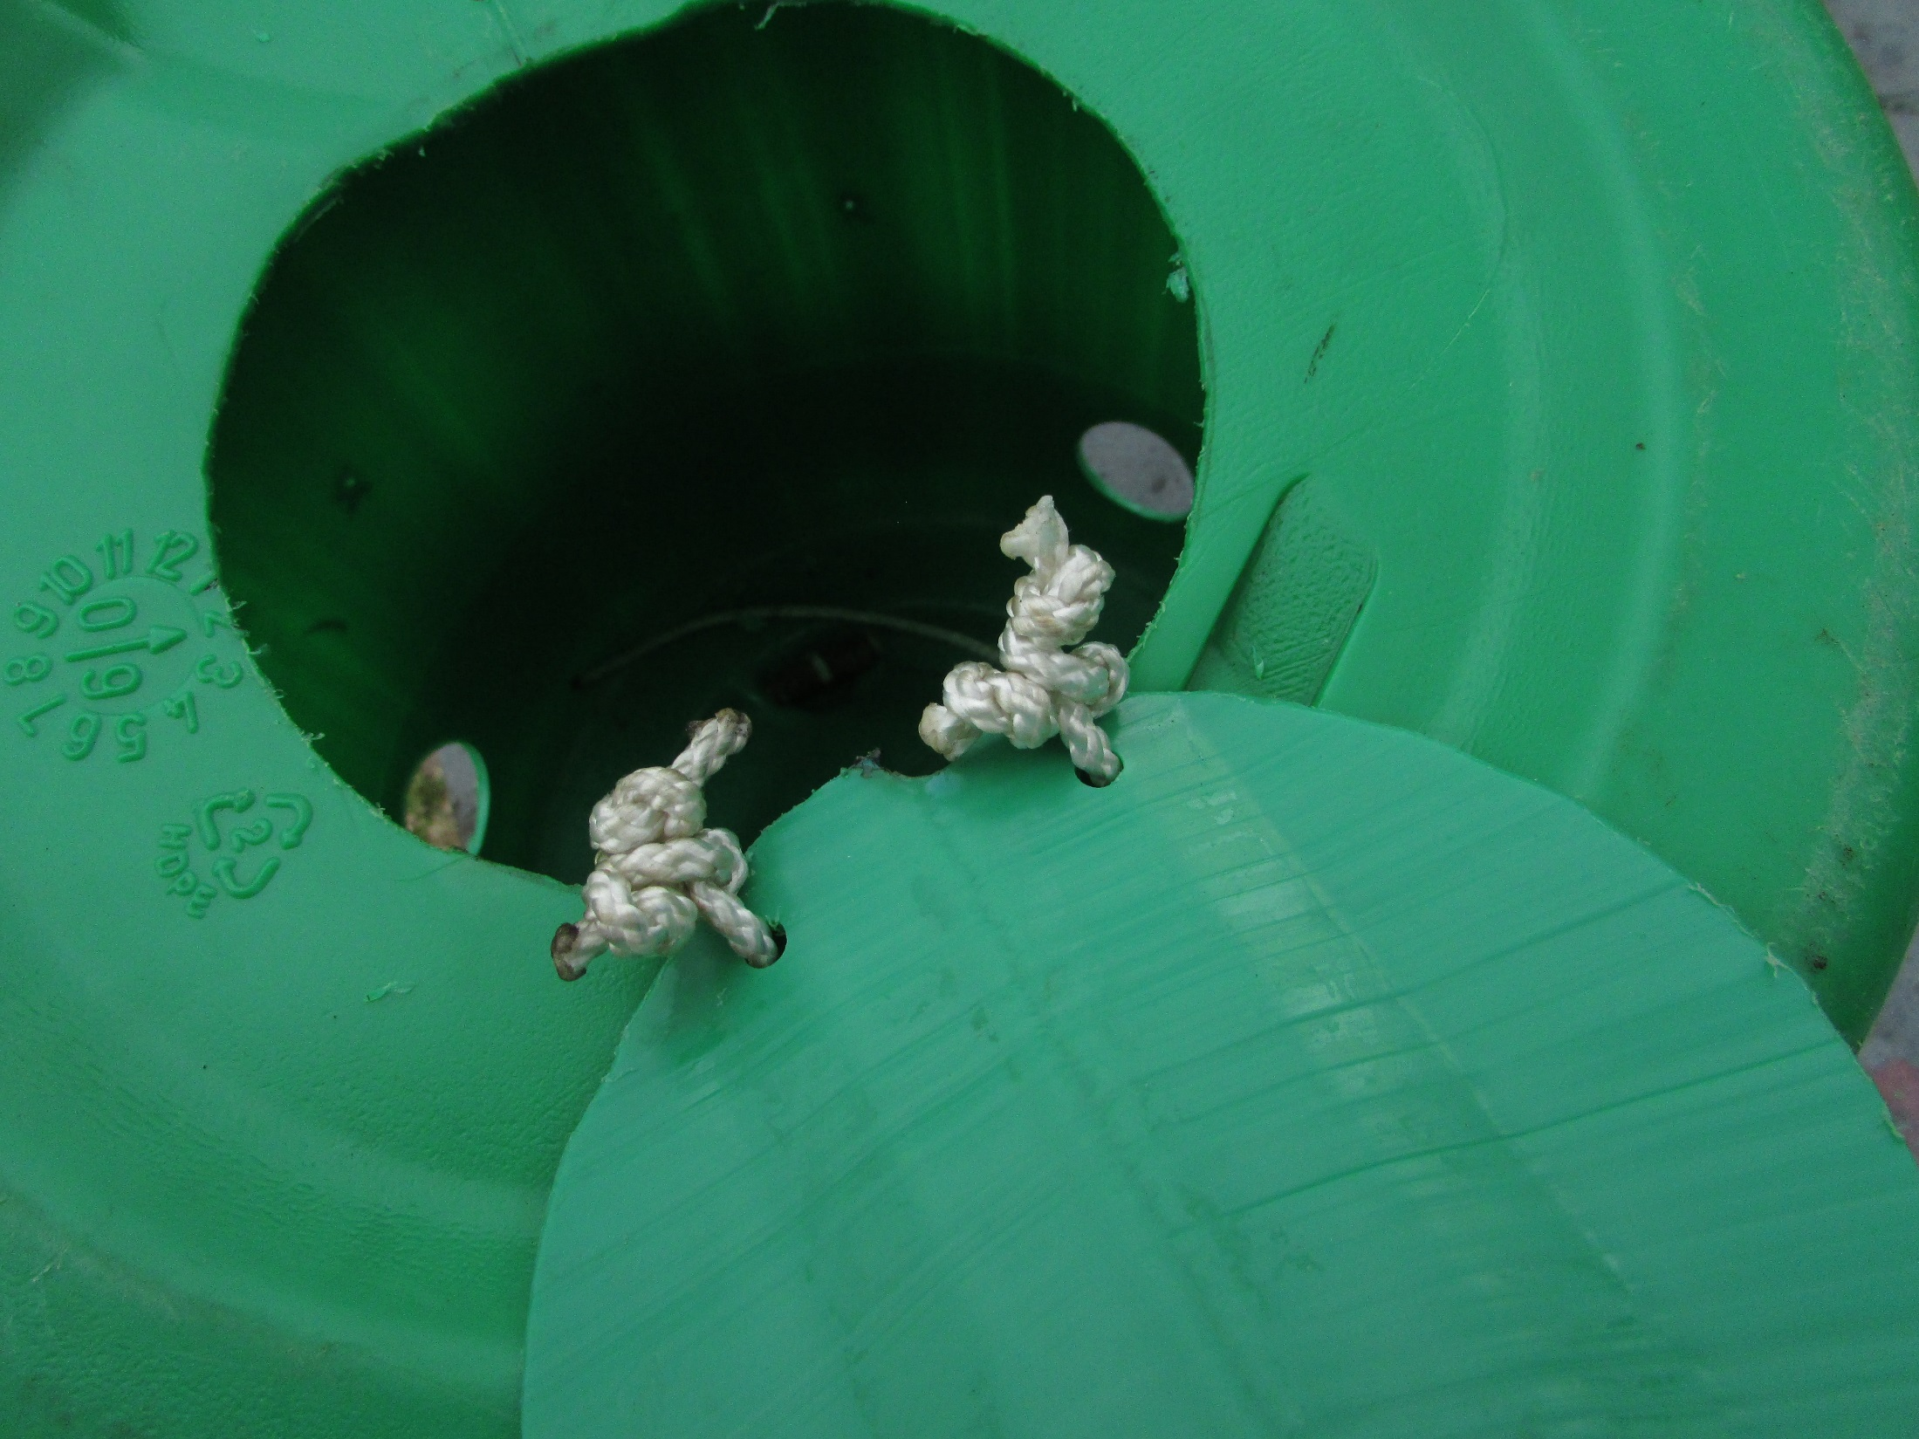

Slide 28
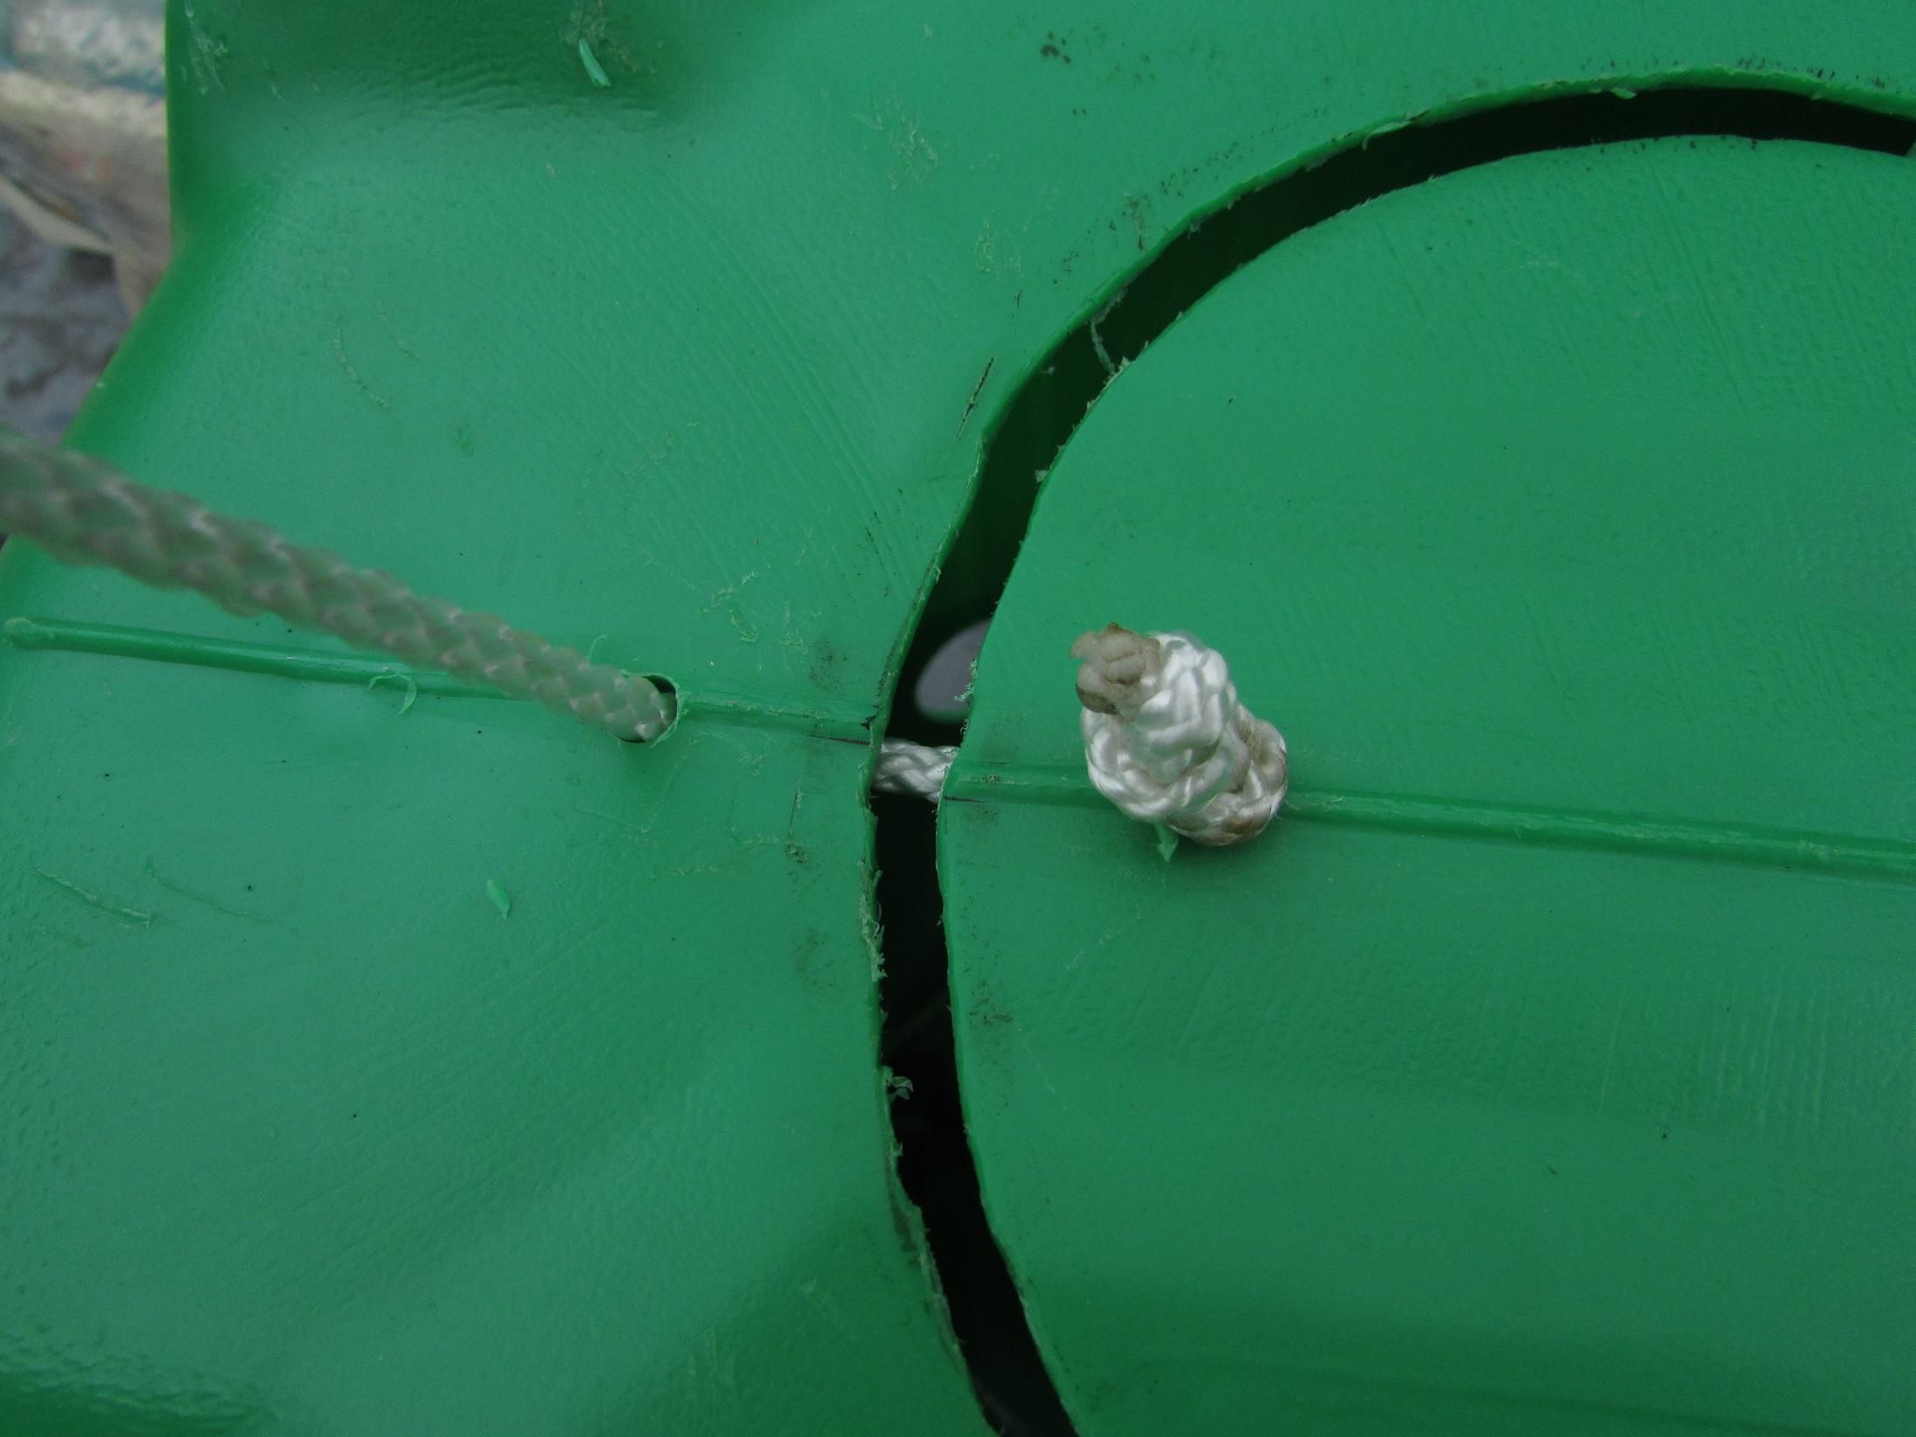
Latch cord must be long enough
to allow the trap door to
be opened fully

Slide 29
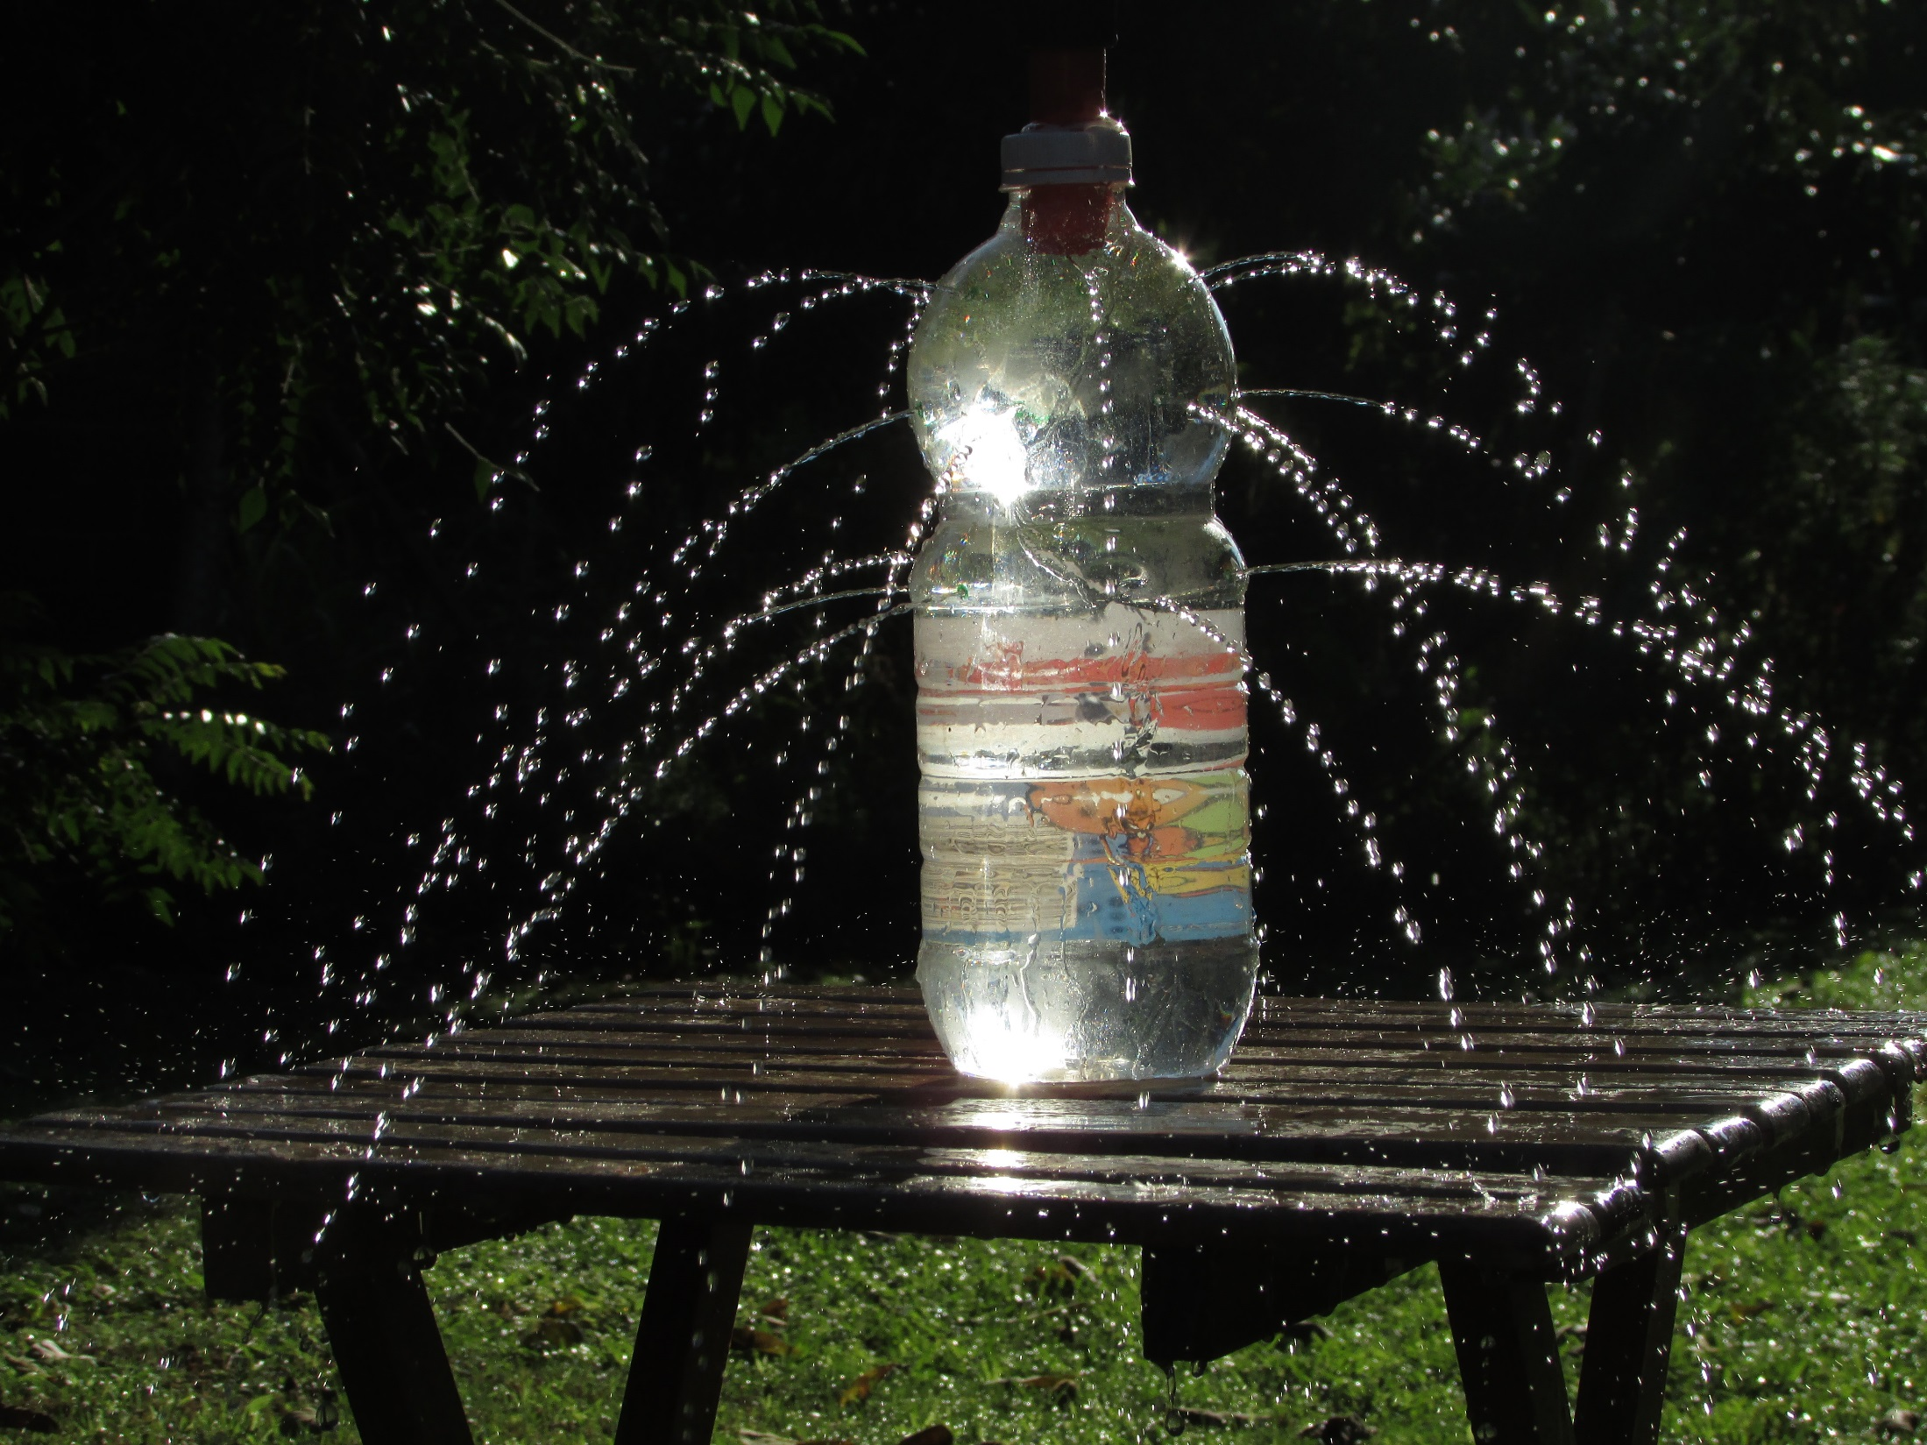
1. Drill holes
2. Cut out cap
3. Screw bottle
into central
hole from
the bottom
4. Fill with gravel

Slide 30
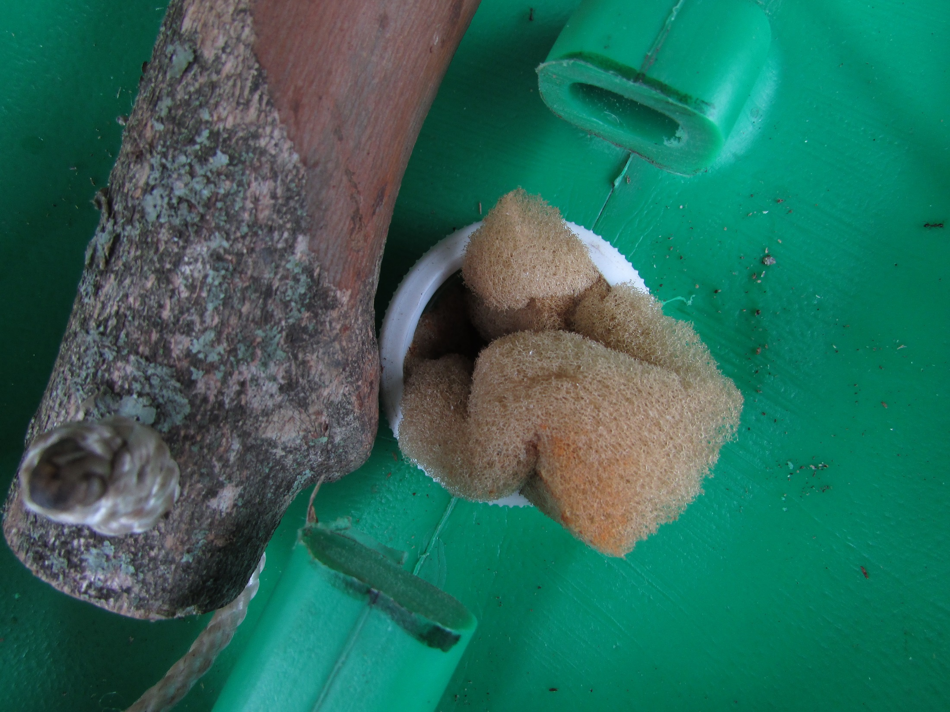
Plug the top of the irrigation
hole with a sponge.

Slide 31
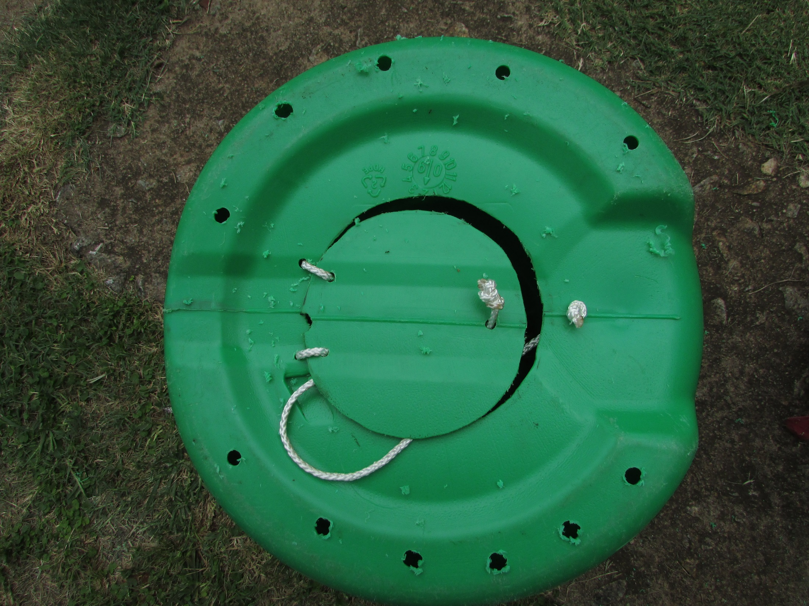
Turn upside down and drill
8 mm drainage holes.

Slide 32
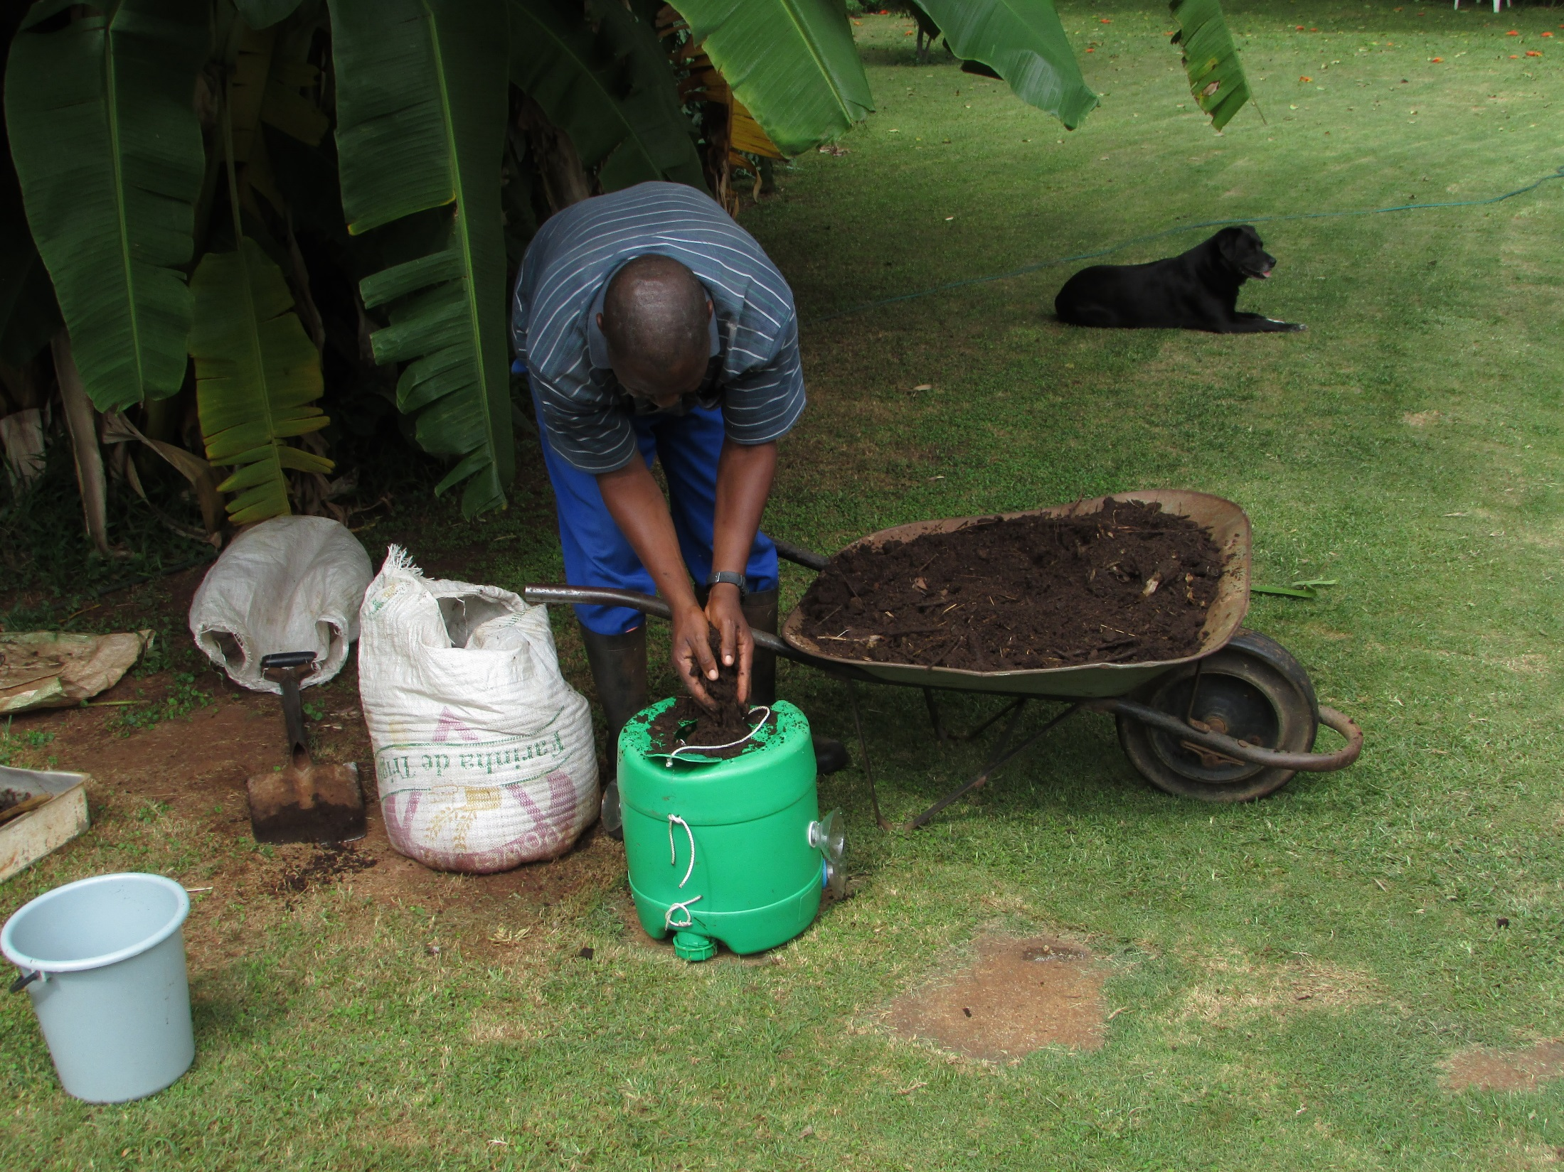
Fill with potting soil.

Slide 33
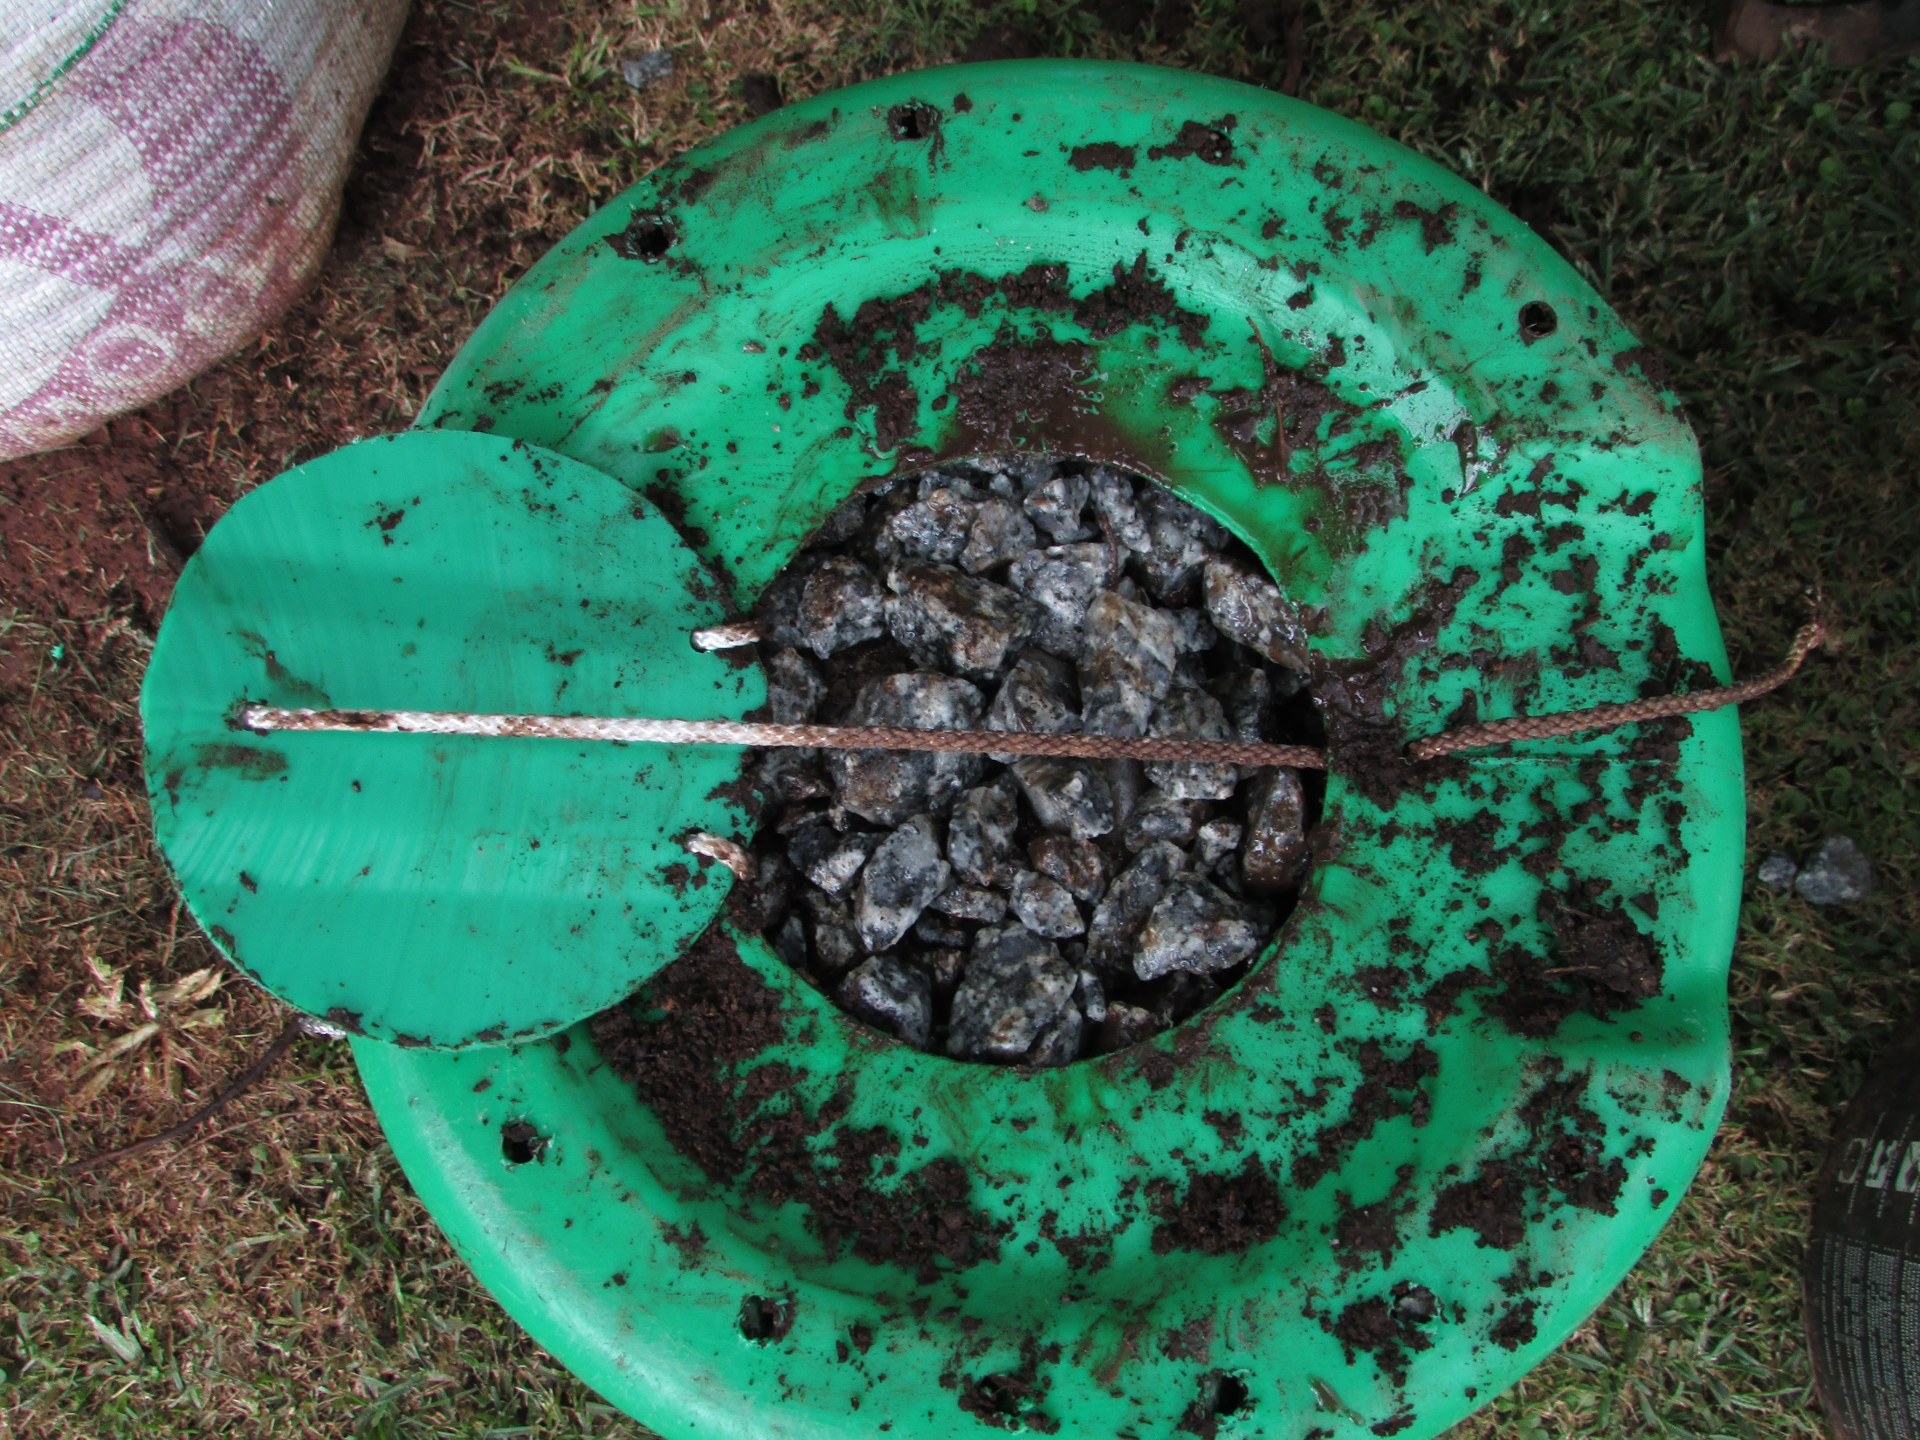
Add a layer of gravel
pushing it to the sides.

Slide 34
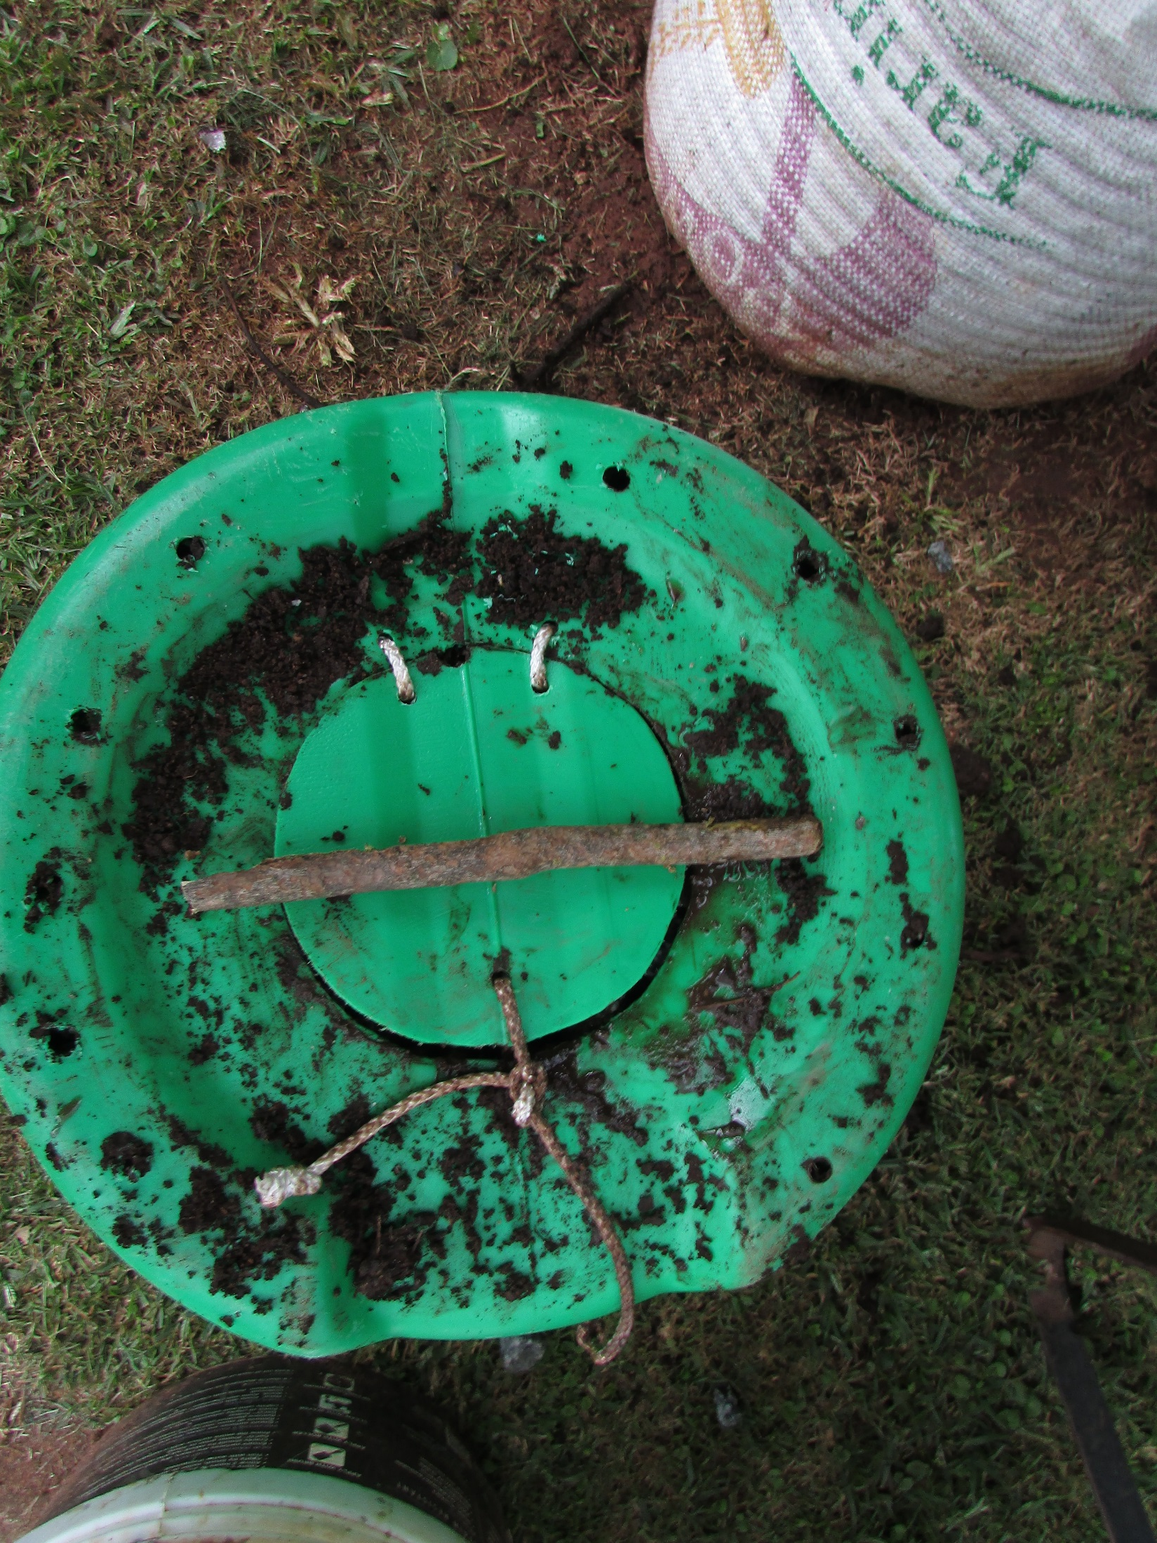
Close the latch and
prepare a wedge stick

Slide 35
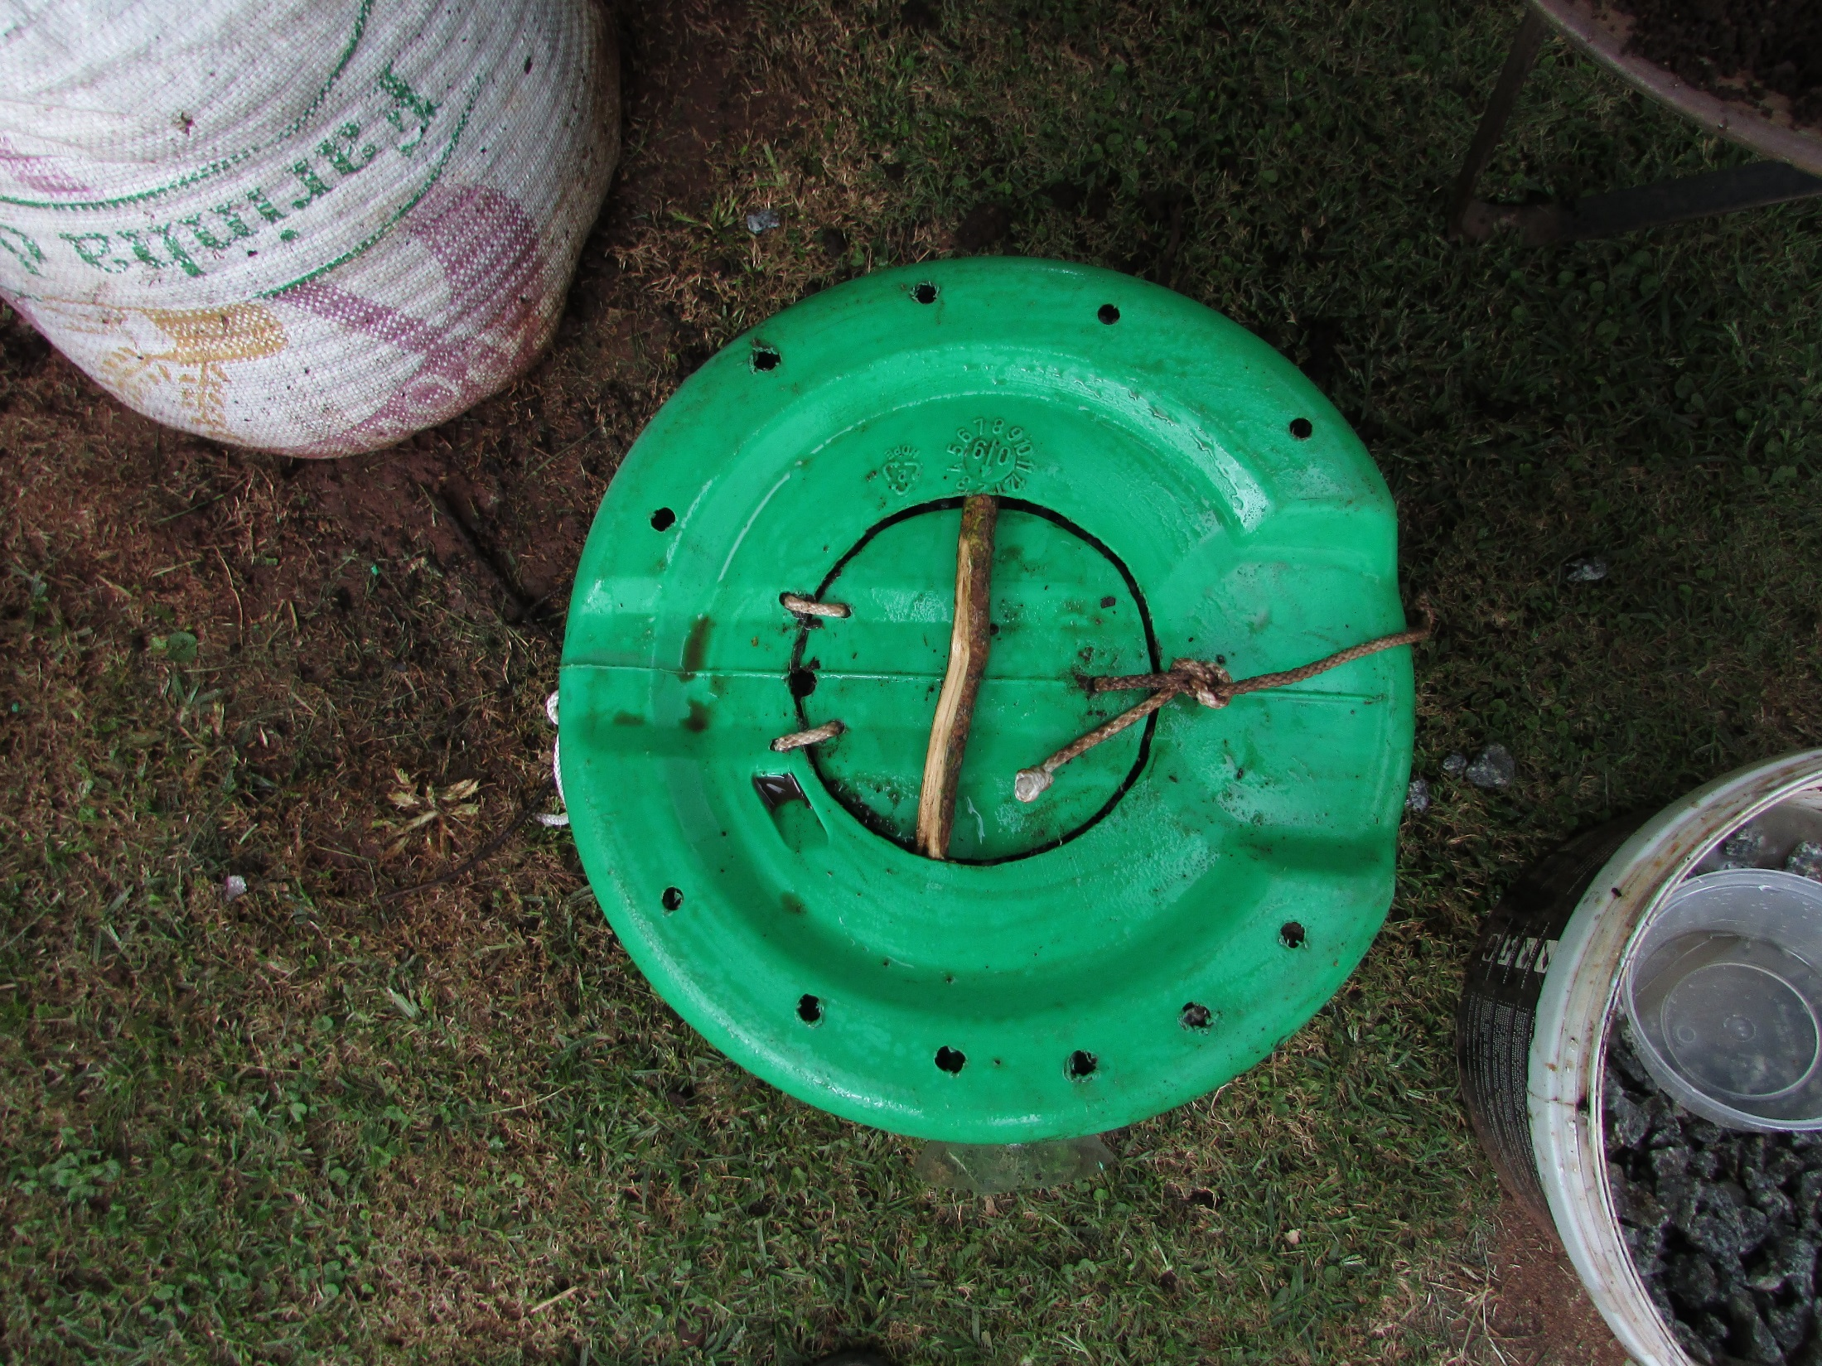

Slide 36
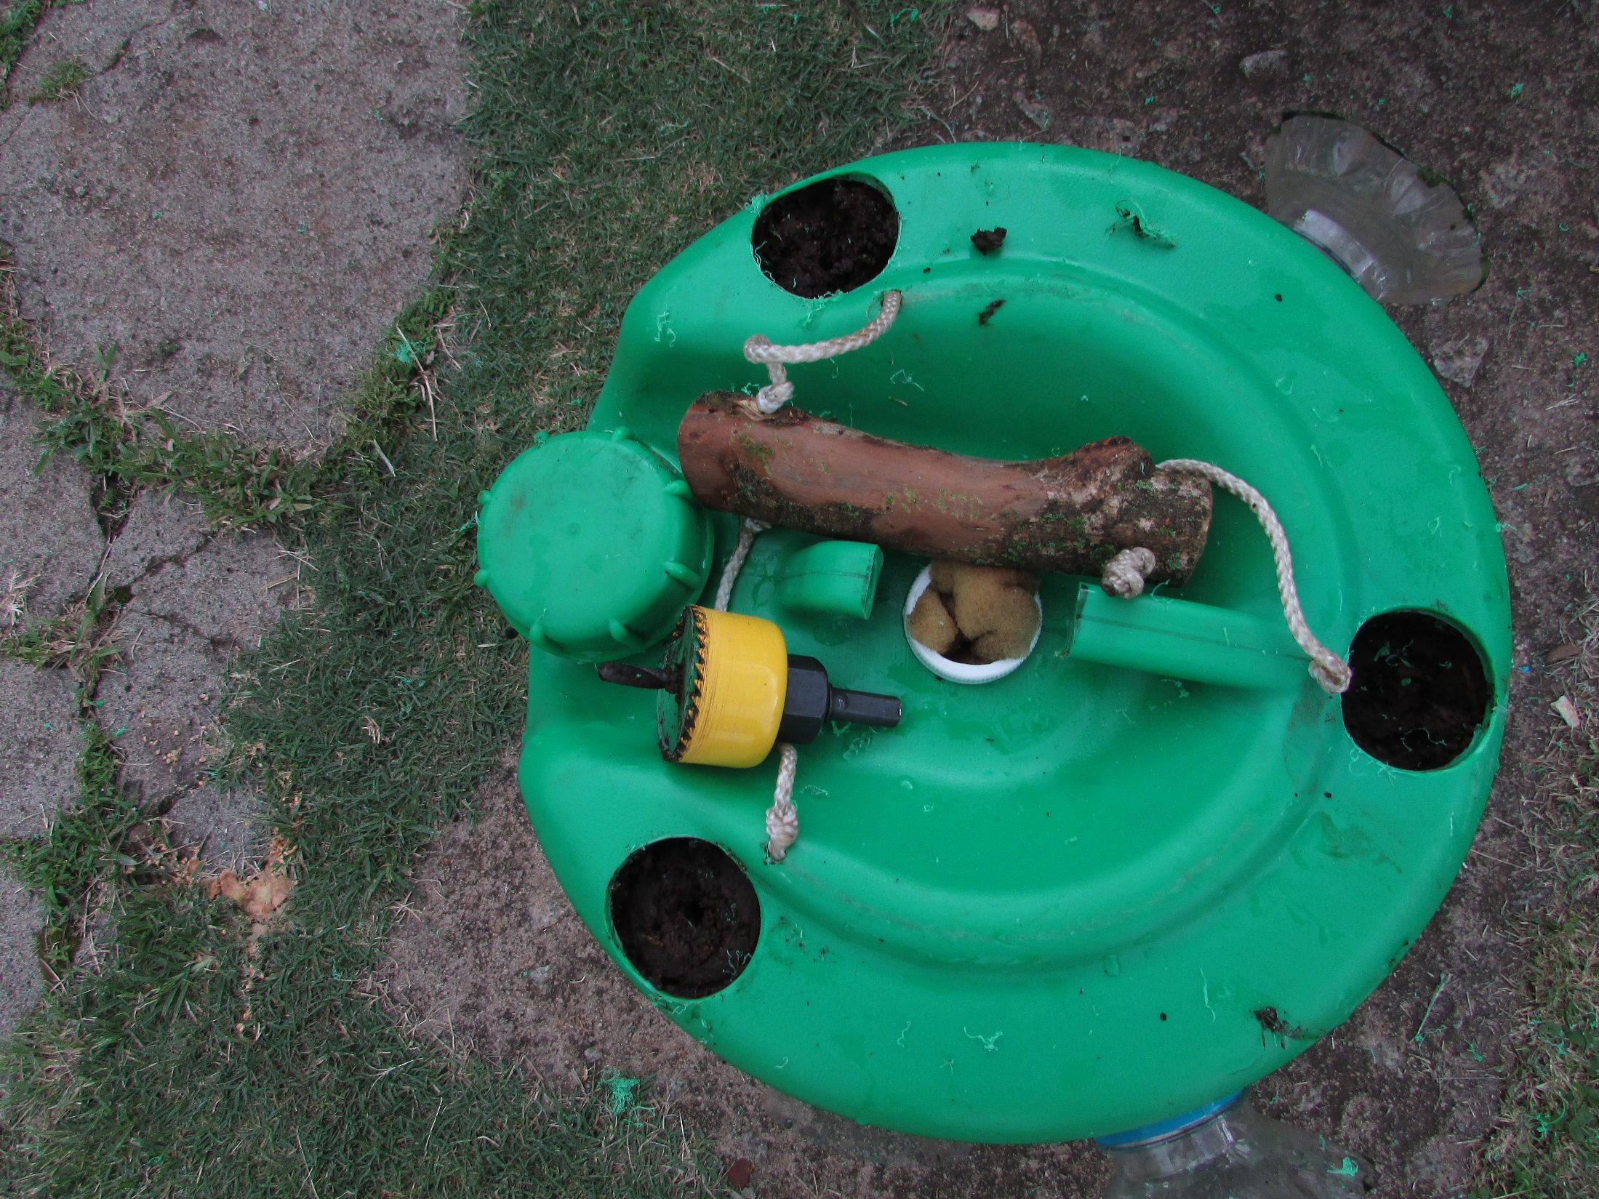
Drill three holes for covo plants

Slide 37
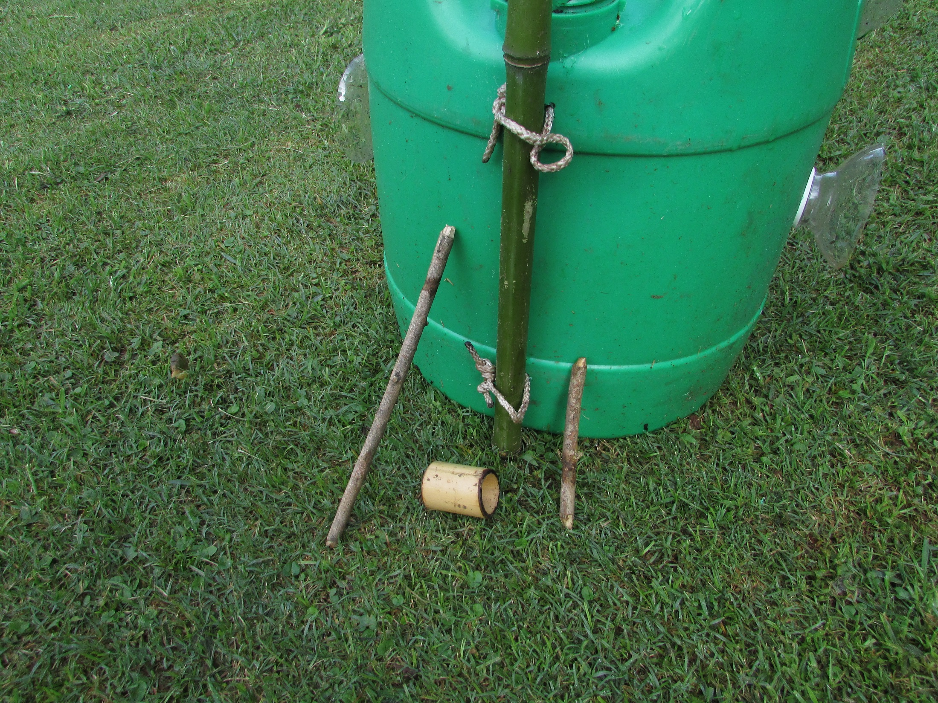
Tomato
stake
1 X long toggle
1 x short
toggle
A retaining ring

Slide 38
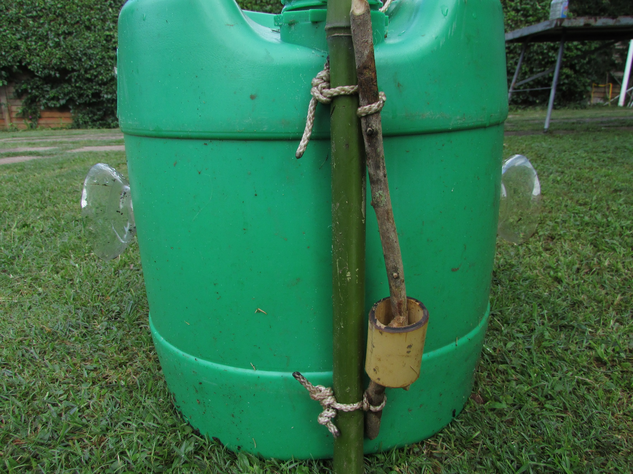
Twist to tighten
and secure ends
in retaining ring

Slide 39
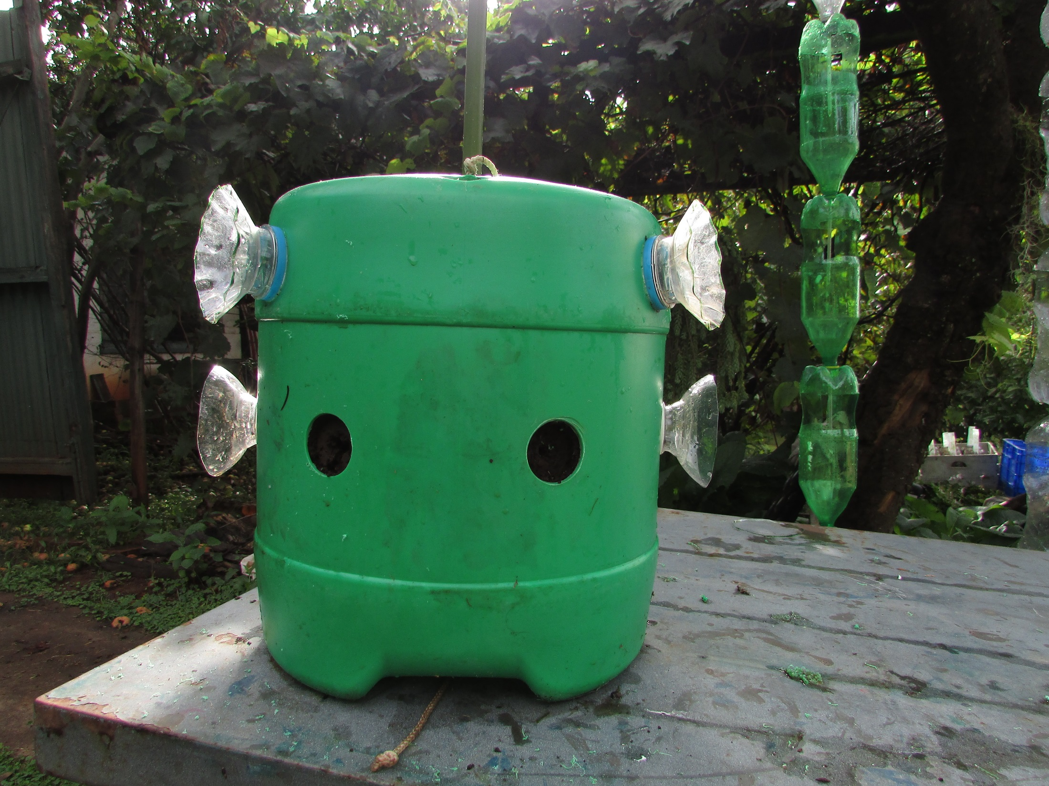
Drill any other
plant stations

Slide 40
